Slide 1
Node Proximity and Embeddings

Slide 2
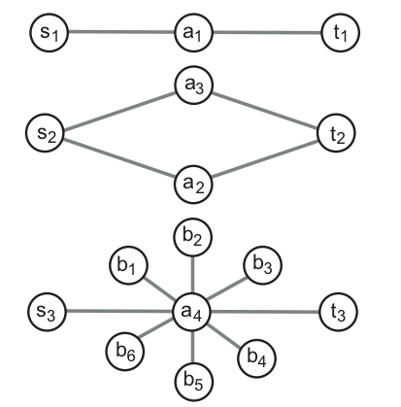
In which network is s-t most similar?
s
t
1
s
t
(s,t) in 2 more similar than in 1 and 3:
Linked via more paths!
s
t
2
3
s
t

Slide 3
What is a ``good’’ Proximity?
…
Multiple Connections
Quality of connection
Direct & In-directed Conns
Length, Degree, Weight…

Slide 4
Random walk with restart
10
9
12
2
1
8
3
11
4
6
5
7
Notes:
4
Basically, it is a random walk on the graph, with some small probability to return to the query node at each step.

Slide 5
Random walk with restart
0.03
 | Node 4
Node 1 Node 2 Node 3 Node 4 Node 5 Node 6 Node 7 Node 8 Node 9 Node 10 Node 11 Node 12 | 0.13 0.10 0.13 0.22 0.13 0.05 0.05 0.08 0.04 0.03 0.04 0.02
0.04
10
0.10
9
12
0.13
2
0.08
0.02
1
8
0.13
11
3
0.04
4
0.05
6
5
0.13
7
0.05
Nearby nodes, higher scores
Ranking vector
More red, more relevant
Notes:
5

Slide 6
Computing RWR
p = c B p + (1-c)/n 1
Ranking vector
Adjacency matrix
Restart p
Starting vector
9
10
1
2
12
1
8
3
11
4
5
6
7
n x 1
n x n
n x 1
Notes:
6

Slide 7
Q: Given query i, how to solve it?
Query
?
?
Ranking vector
Adjacency matrix
Ranking vector
Starting vector

Slide 8
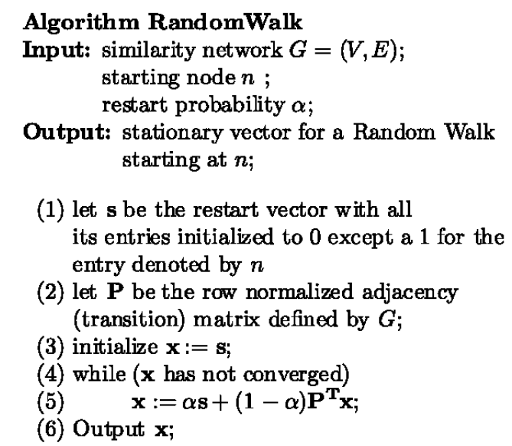
col
Px

Slide 9
Properties
Space complexity:
O(n²)
O(M+n)
Using Pagerank style storage
M: adjacency list
Time complexity:
O(n²)
In practice, can be much faster using SimRank kind of optimization.

Slide 10
Node Embeddings
Source: Graph Representation learning, AAAI 2019
Stanford slides by Chris Manning

Slide 11
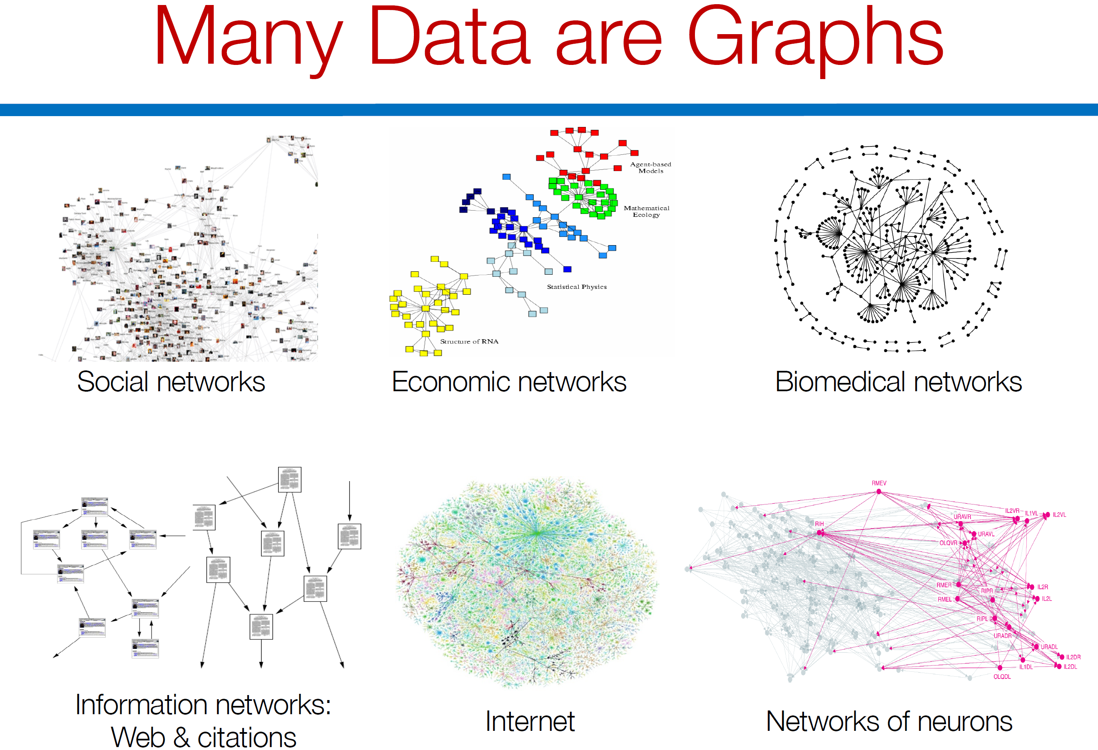

Slide 12
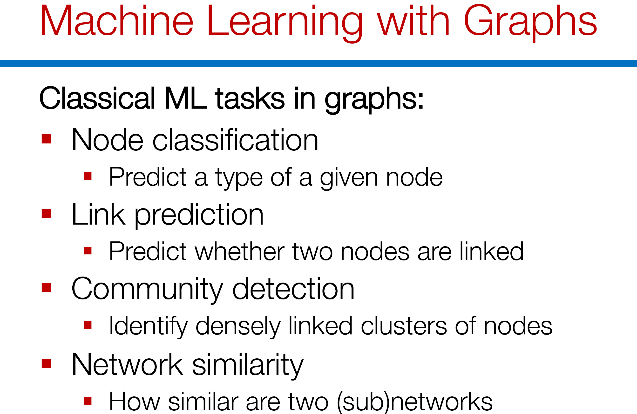

Slide 13
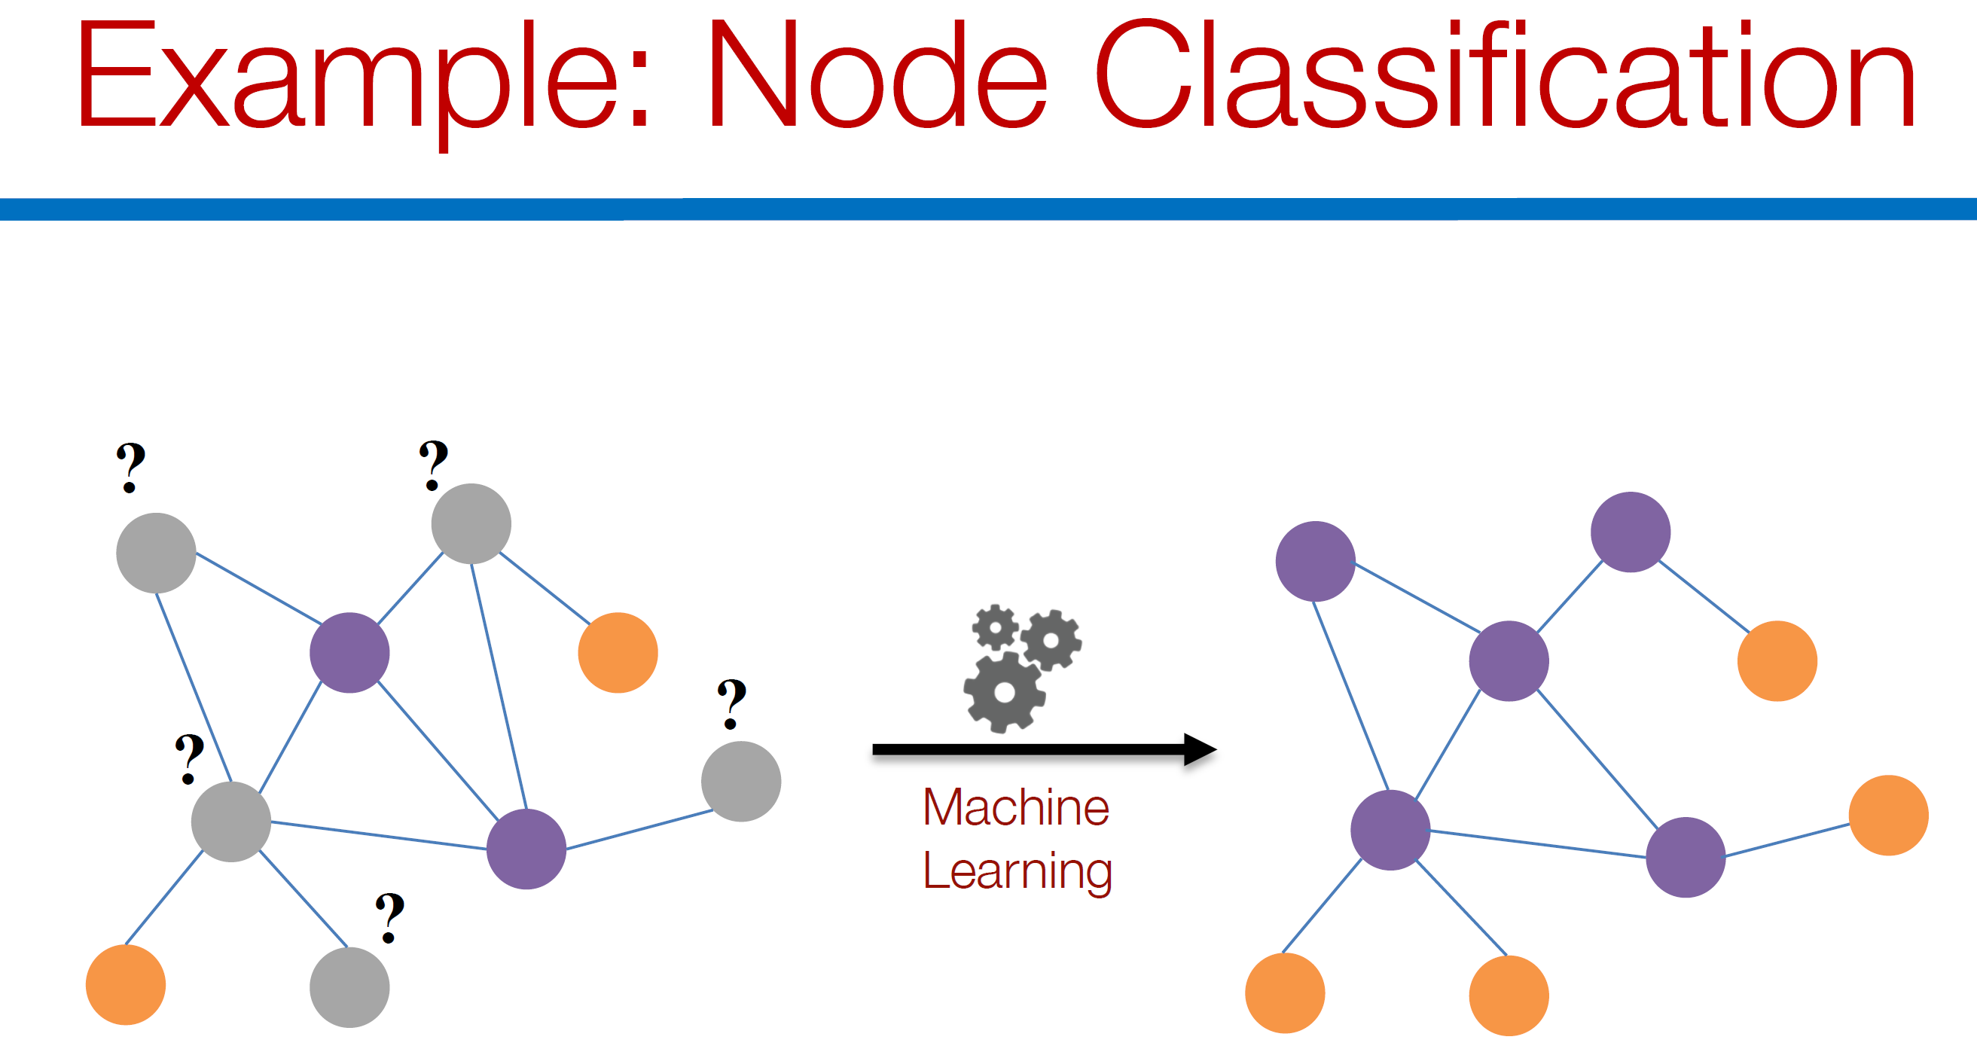

Slide 14
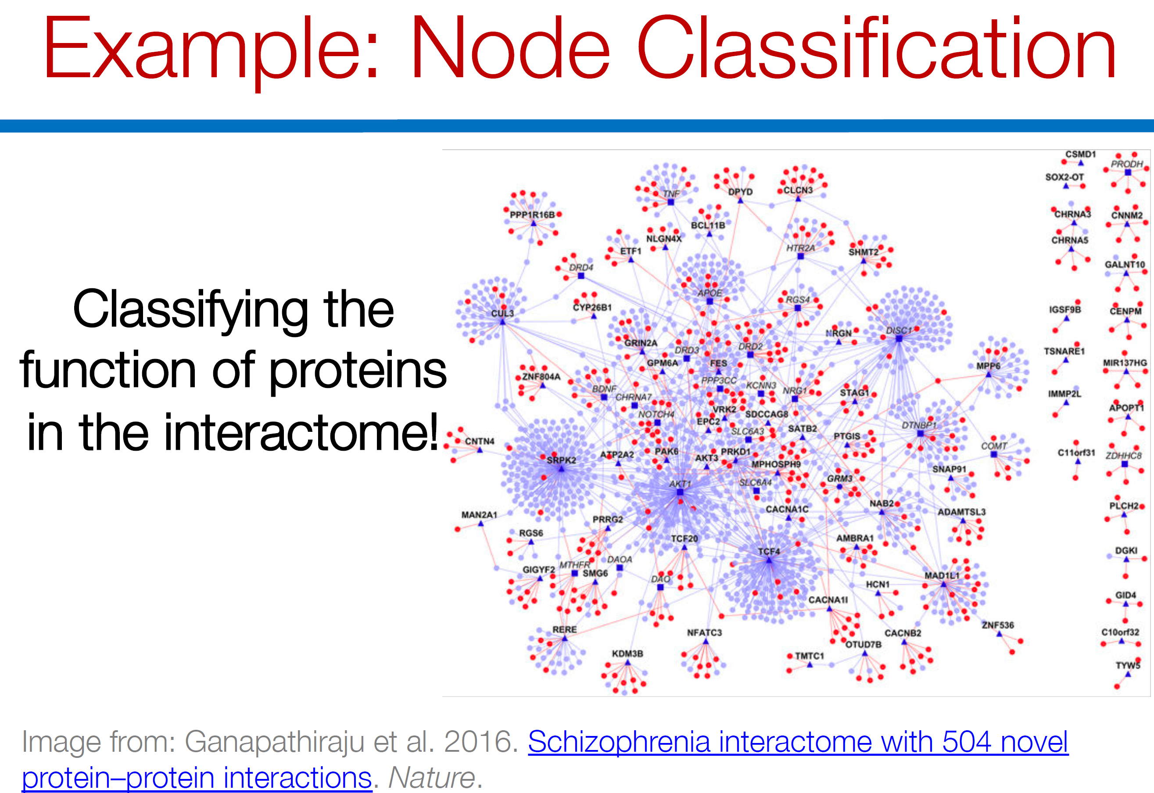

Slide 15
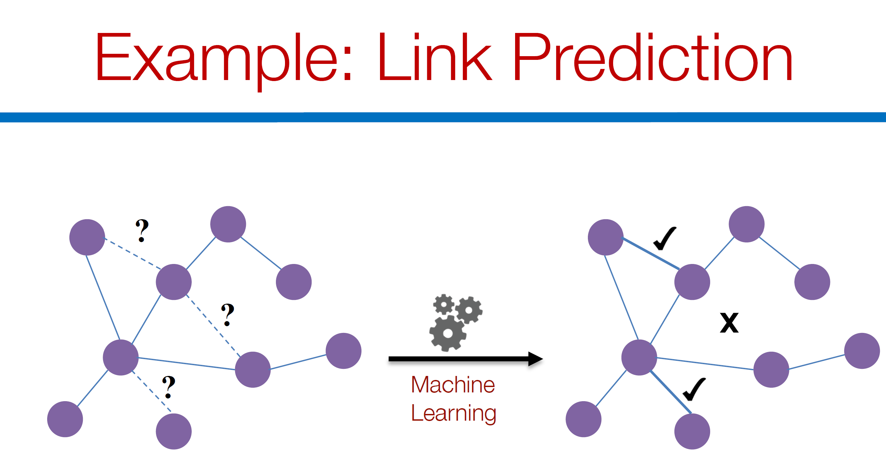

Slide 16
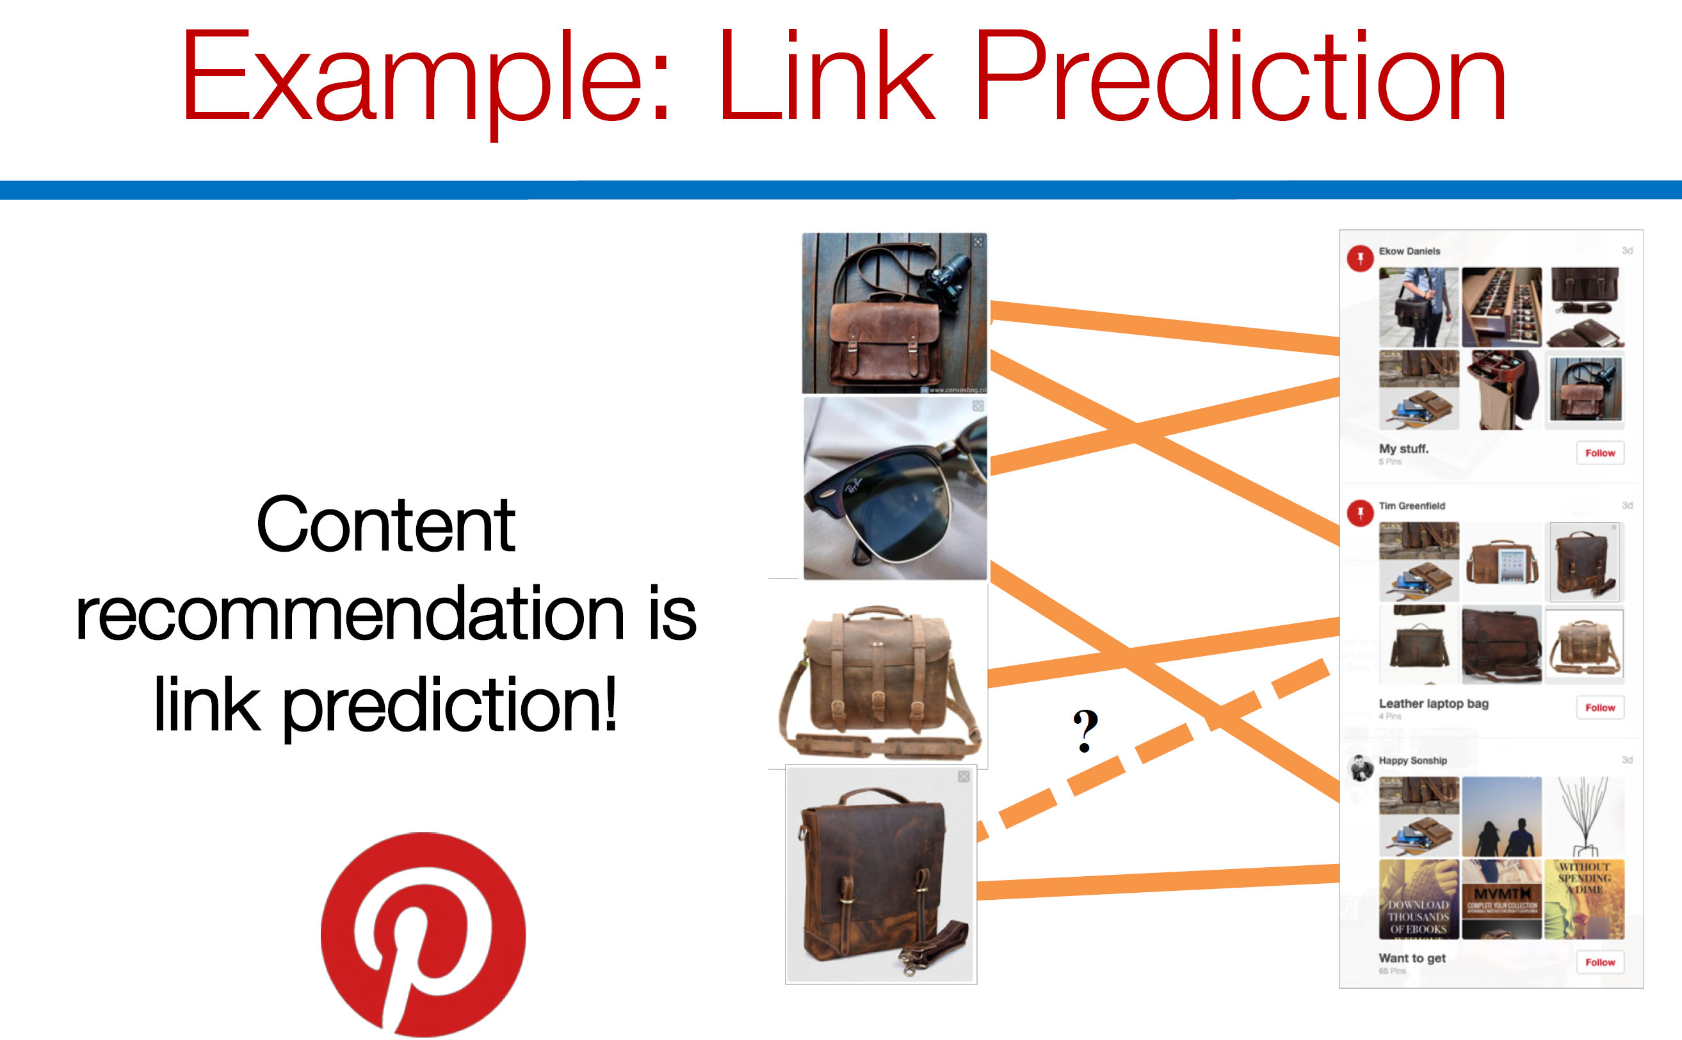

Slide 17
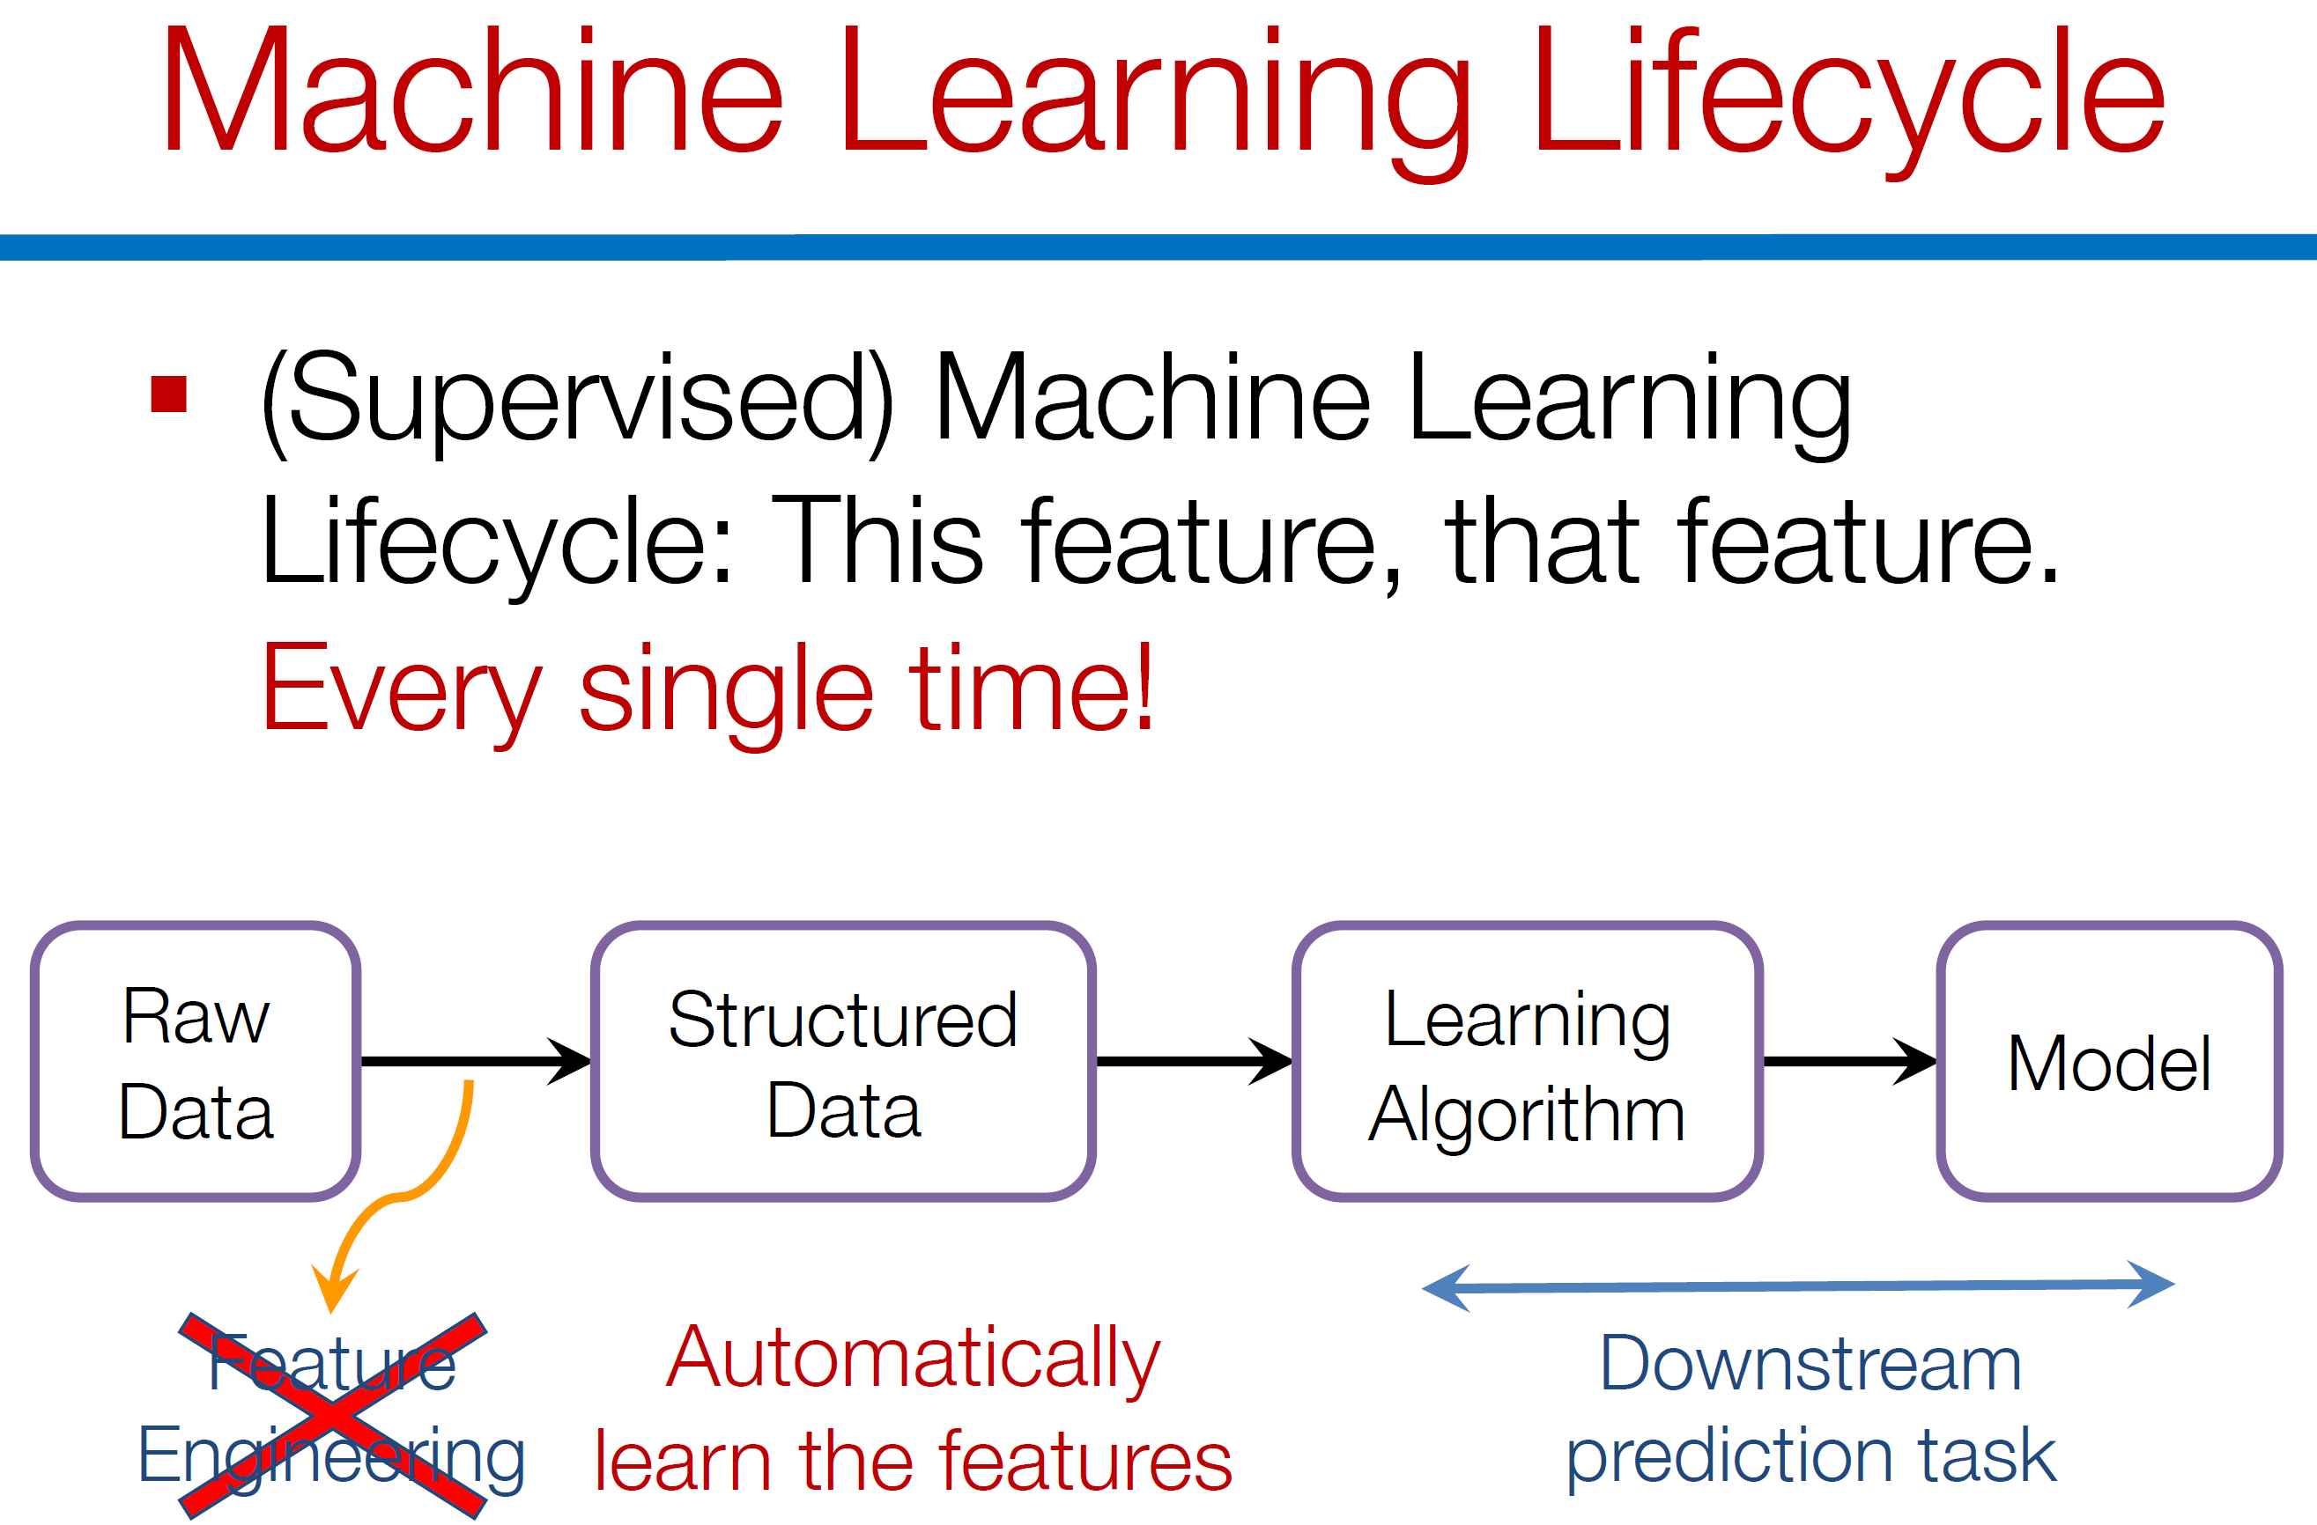

Slide 18
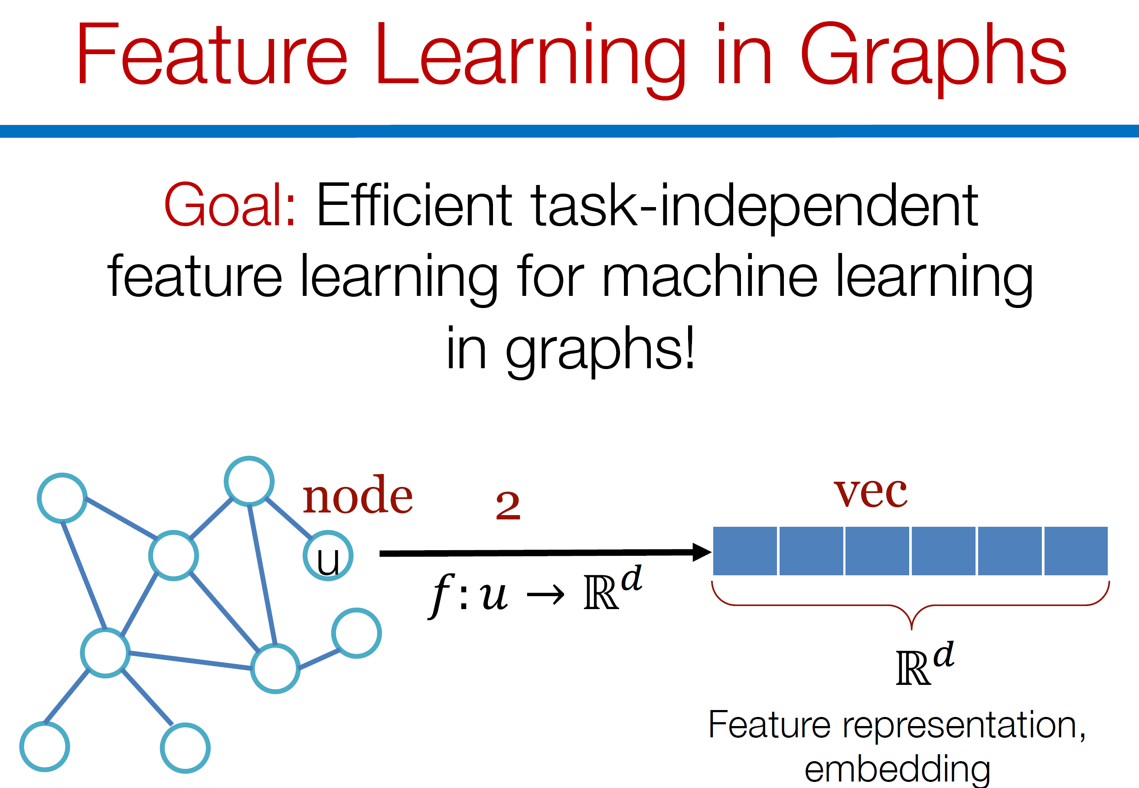

Slide 19
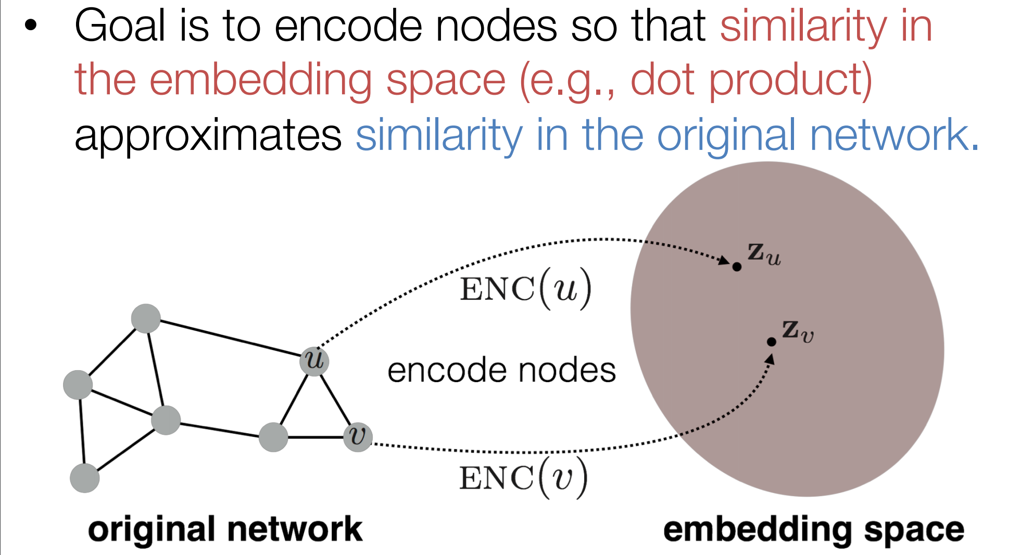

Slide 20
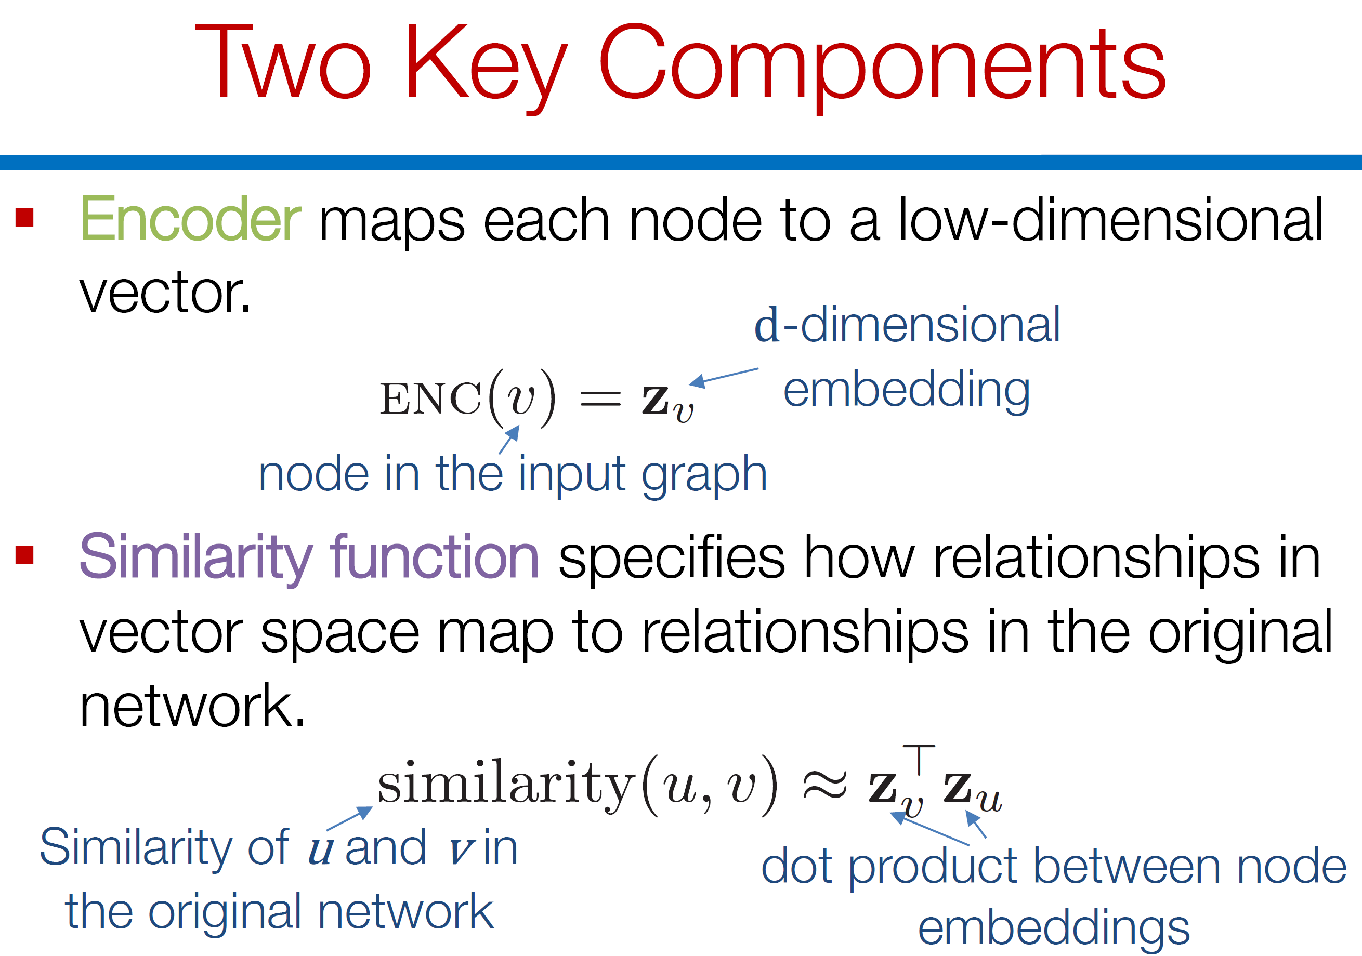

Slide 21
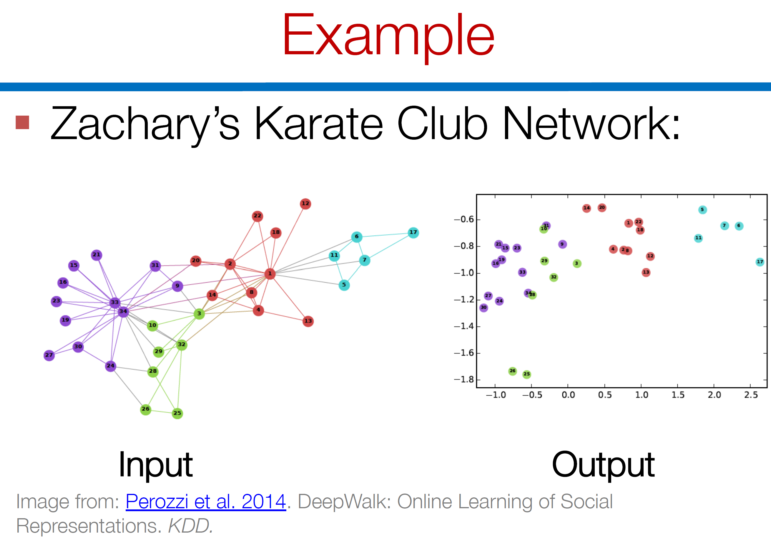

Slide 22
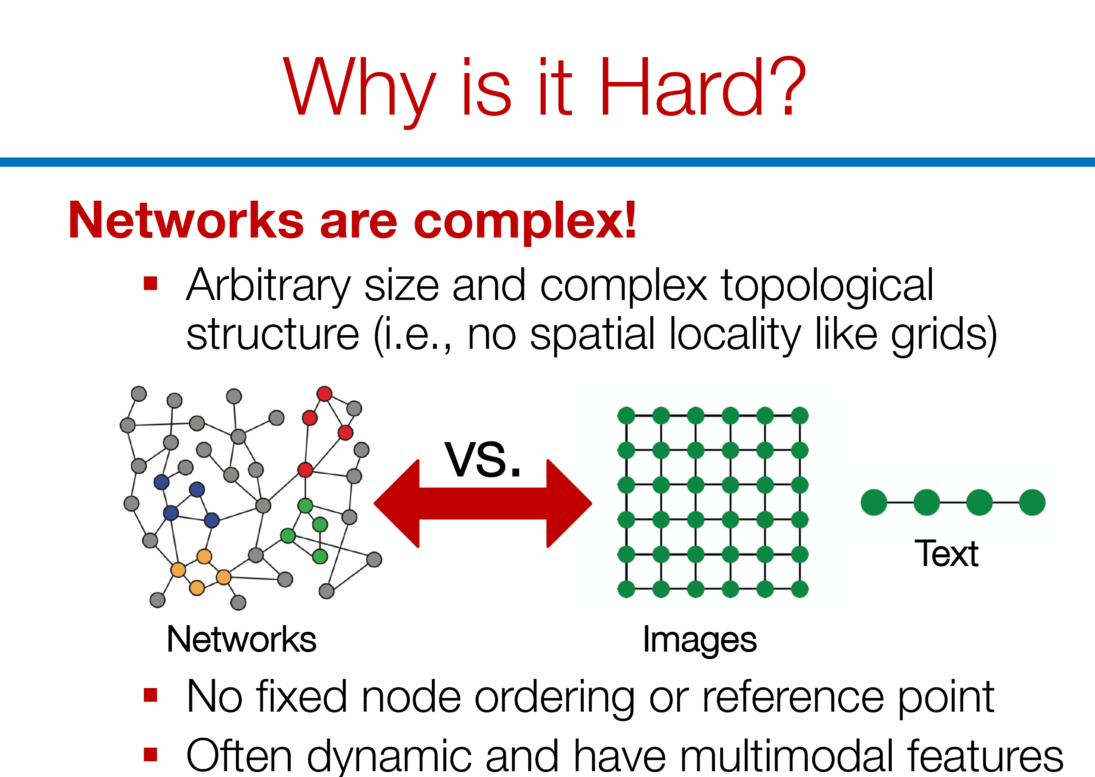

Slide 23
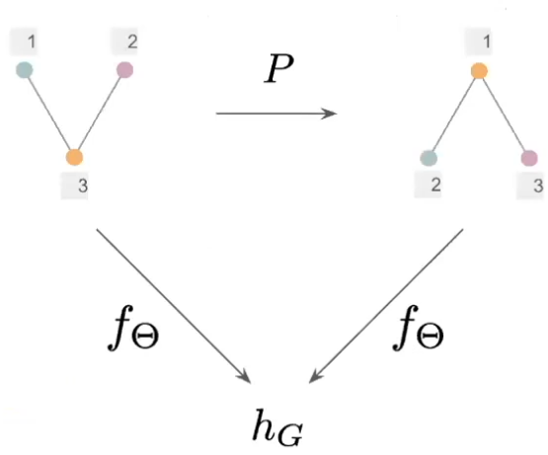
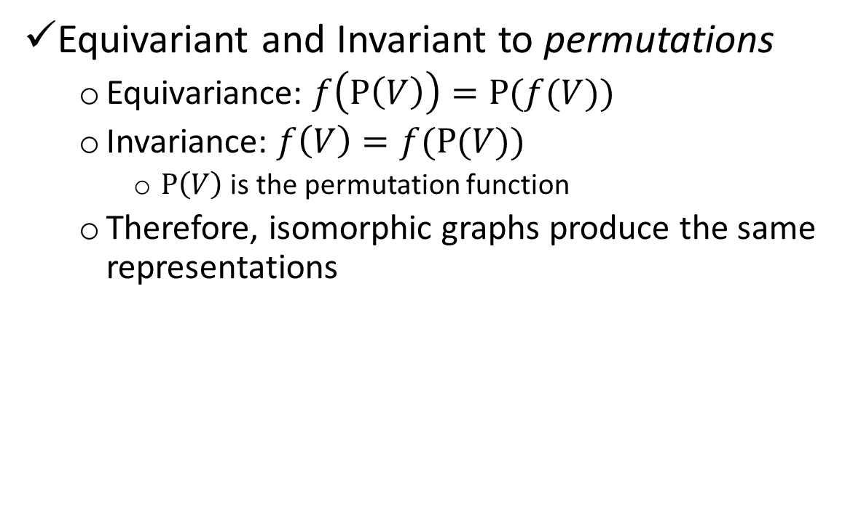
GNNs much guarantee..
Equivariant and Invariant to permutations
Equivariance: $f\left(P\left(V\right)\right)=P(f(V))$
Invariance: $f\left(V\right)=f(P(V))$
$P\left(V\right)$ is the permutation function
Therefore, isomorphic graphs produce the same representations

Slide 24
Existing work
What started this race?
Word2Vec
Convert words to vectors
Developed by Mikolov et al. from Google in 2013
148238 citations already.
DeepWalk and Node2Vec extends this same framework to nodes in a graph

Slide 25
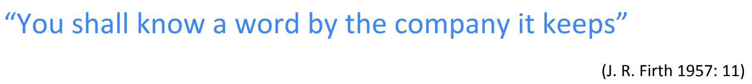
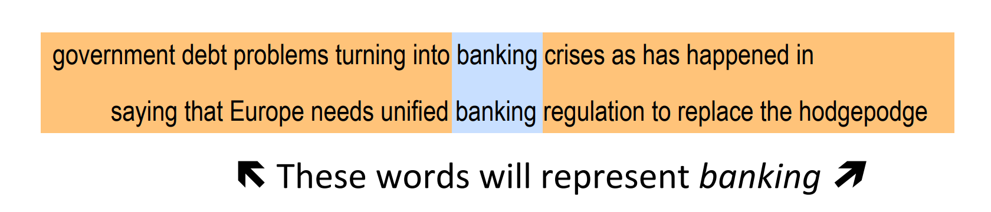
Word2Vec [many slides taken from the Stanford lecture]
Similar words should have similar feature vectors.
When would you say two words are similar?
Idea: Two words are similar if they appear in the company of similar words
Compute the distribution of words around the seed word
Two words are similar, if their distributions are similar.
Are we done?

Slide 26
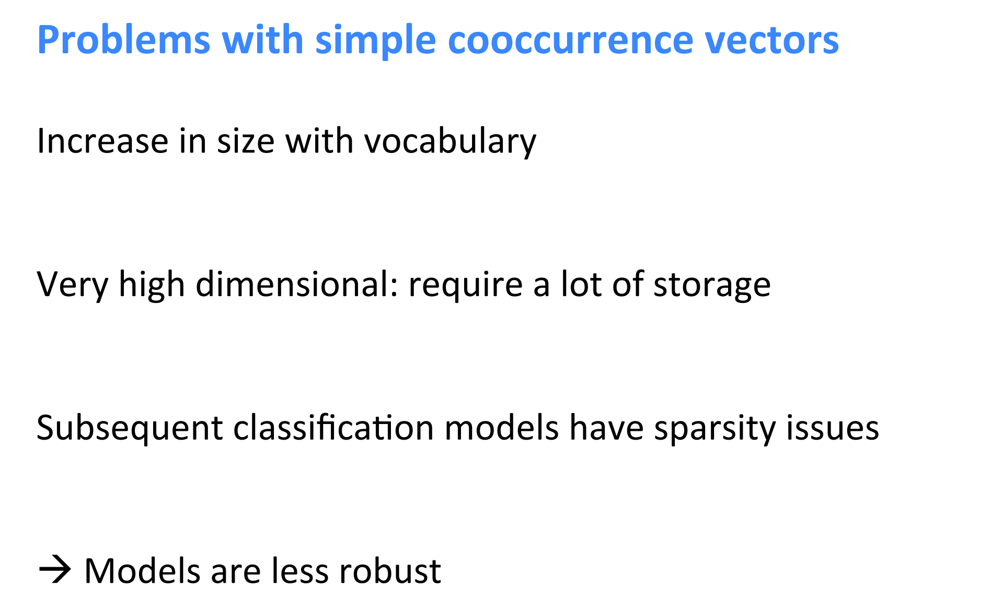

Slide 27
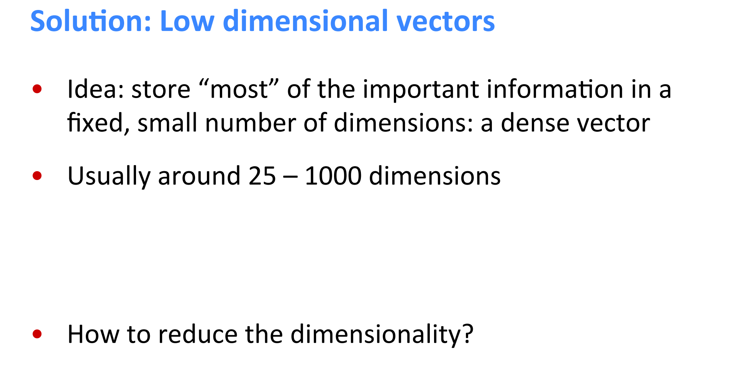

Slide 28
How do you reduce dimensions?
Principal Component Analysis (PCA)
Basic idea:
If two dimensions are correlated, merge them into a single dimension
Any issues?
Not very scalable
Many techniques exist to perform fast matrix factorization
Many papers have shown better results with embeddings

Slide 29
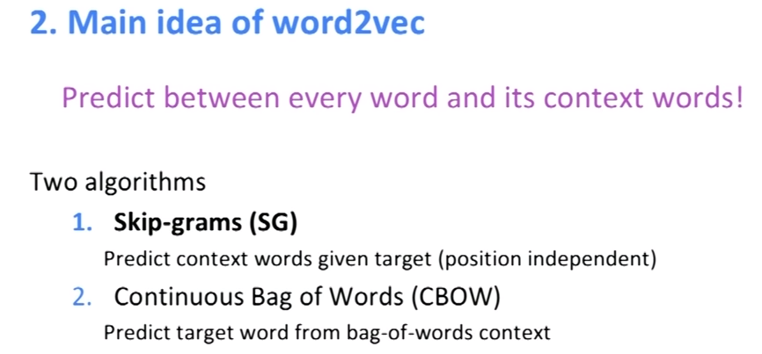

Slide 30
Word2Vec
Input:
Training Corpus
A bunch of documents
Dimensionality of the embedded space
Some other hyper-parameters as well
Output:
Vector representation of every word in training corpus

Slide 31
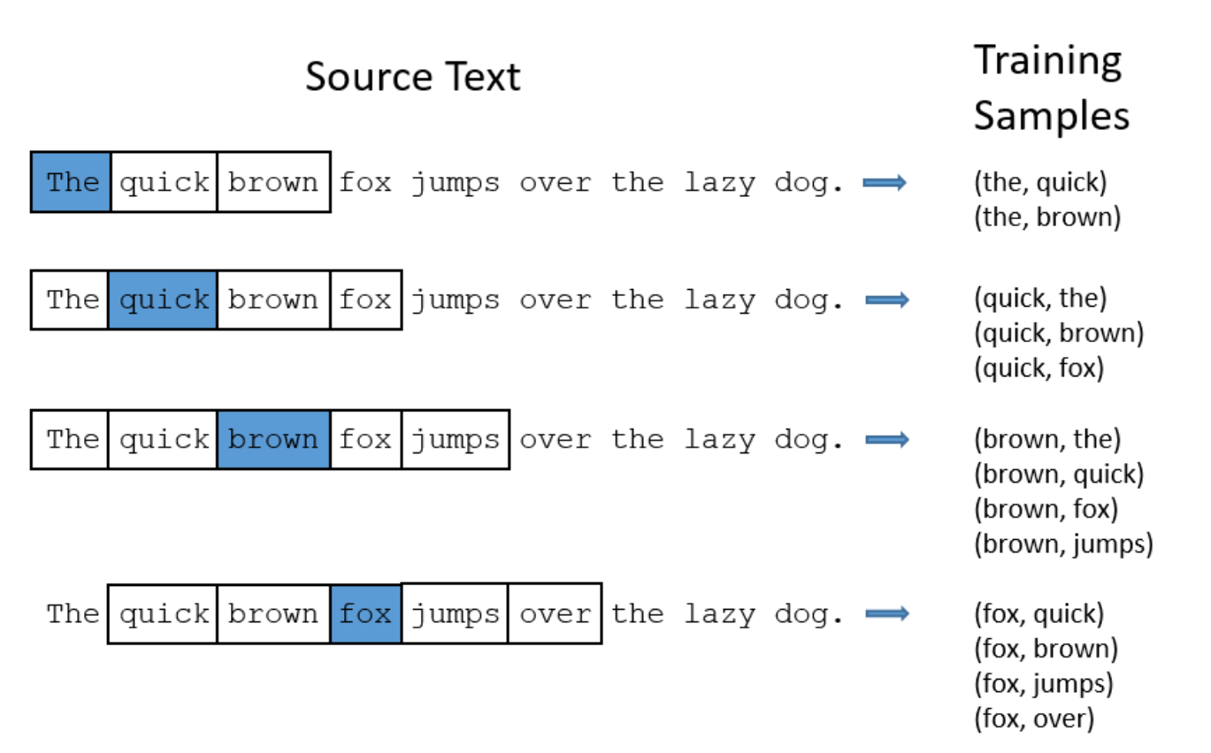
Skip-gram prediction

Slide 32
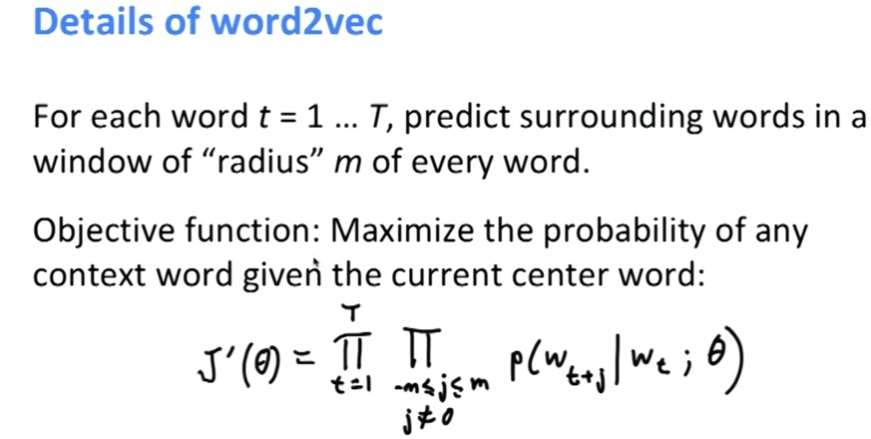
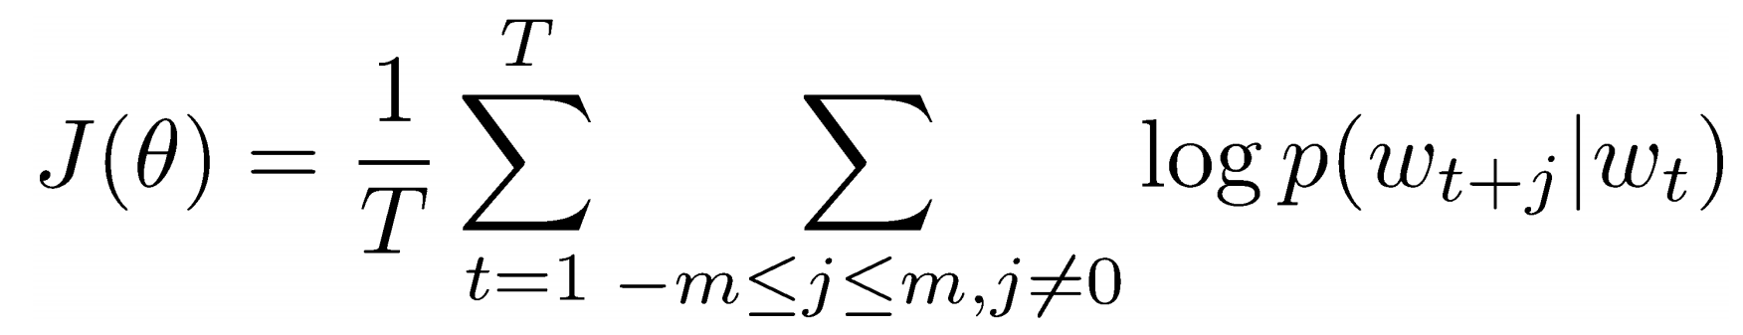
Vector representation of the words

Slide 33
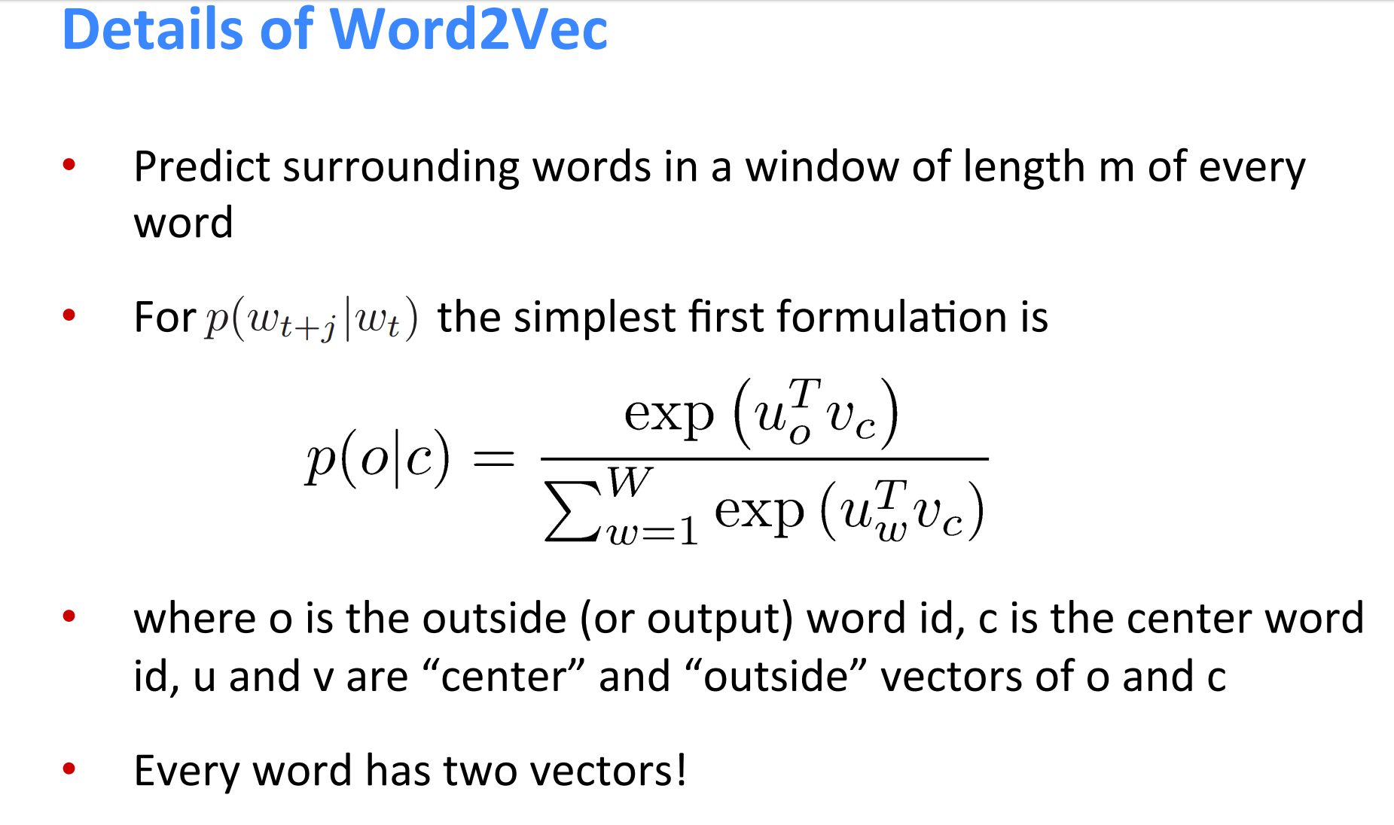
Softmax

Slide 34
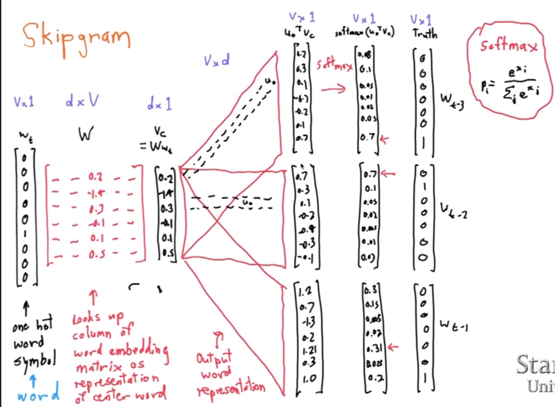

Slide 35
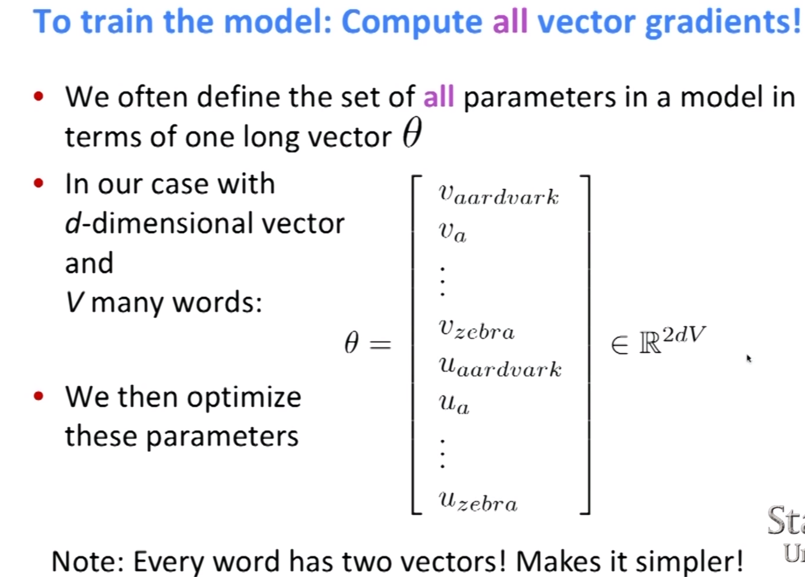

Slide 36
Limitations
Not scalable
Group phrases into a single word
Subsampling
Negative sampling
Needs large amount of data to train
Transductive

Slide 37
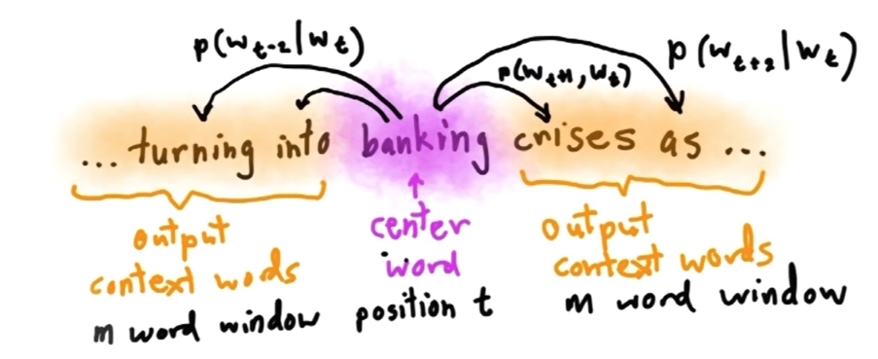
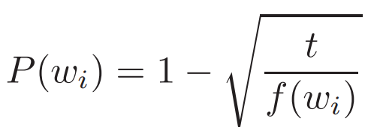
Subsampling
Some words are very frequent
Ex: the, a, into, as, etc.
We don’t need such a large training corpus to compute their vectors
They are not meaningful anyways
They don’t contribute to the context of word either
Solution:
Remove from training corpus!
Higher the frequency, more is the likelihood of being removed

Slide 38
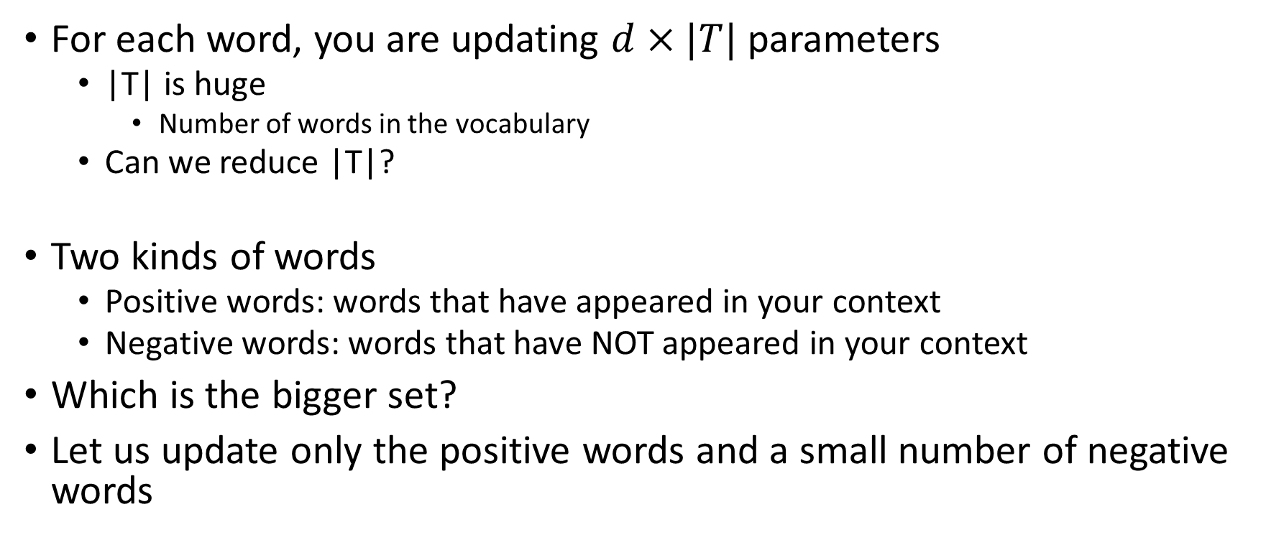
Negative Sampling
For each word, you are updating $d×|T|$ parameters
|T| is huge
Number of words in the vocabulary
Can we reduce |T|?
Two kinds of words
Positive words: words that have appeared in your context
Negative words: words that have NOT appeared in your context
Which is the bigger set?
Let us update only the positive words and a small number of negative words

Slide 39
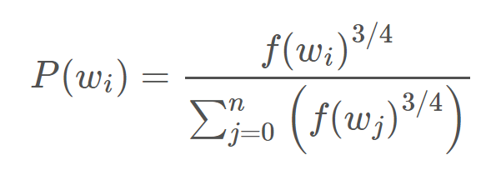
Negative Sampling
Which negative words should we update?
Frequent negative words!

Slide 40
How do you now apply word2Vec to node2vec [KDD 2016]?
Nodes correspond to words
Perform RWR to create context
RWR captures distribution of nodes in the neighborhood
If two nodes, have similar neighborhood, they are close in the network
Therefore, learn feature vectors such that
similar neighborhoods=similar feature vectors

Slide 41
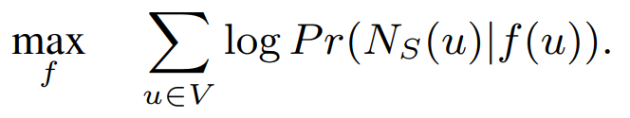
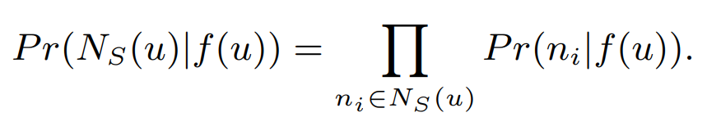
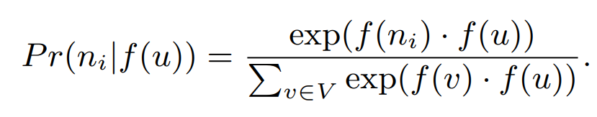
Mathematical Modeling
Objective:
Where
Where

Slide 42
Other settings..
Dynamic networks
It can’t
Nodes with features
It can’t

Slide 43
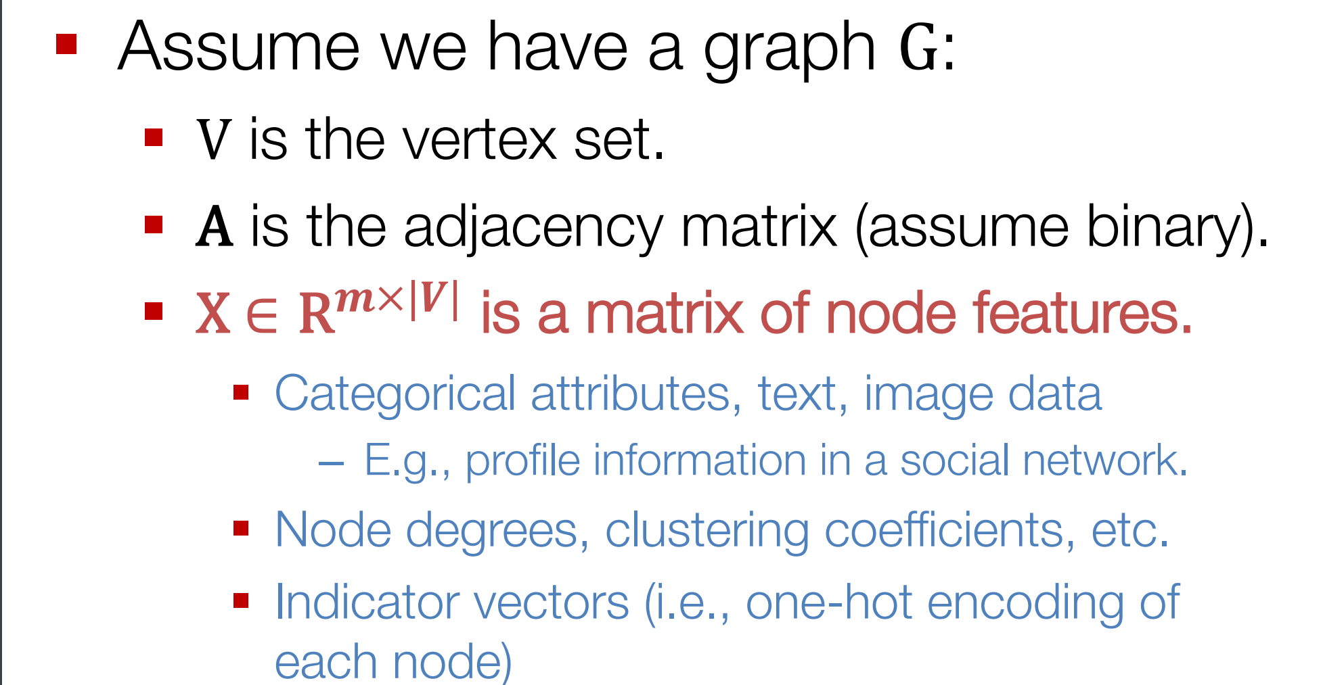
Graph Convolutional Networks (GCN)

Slide 44
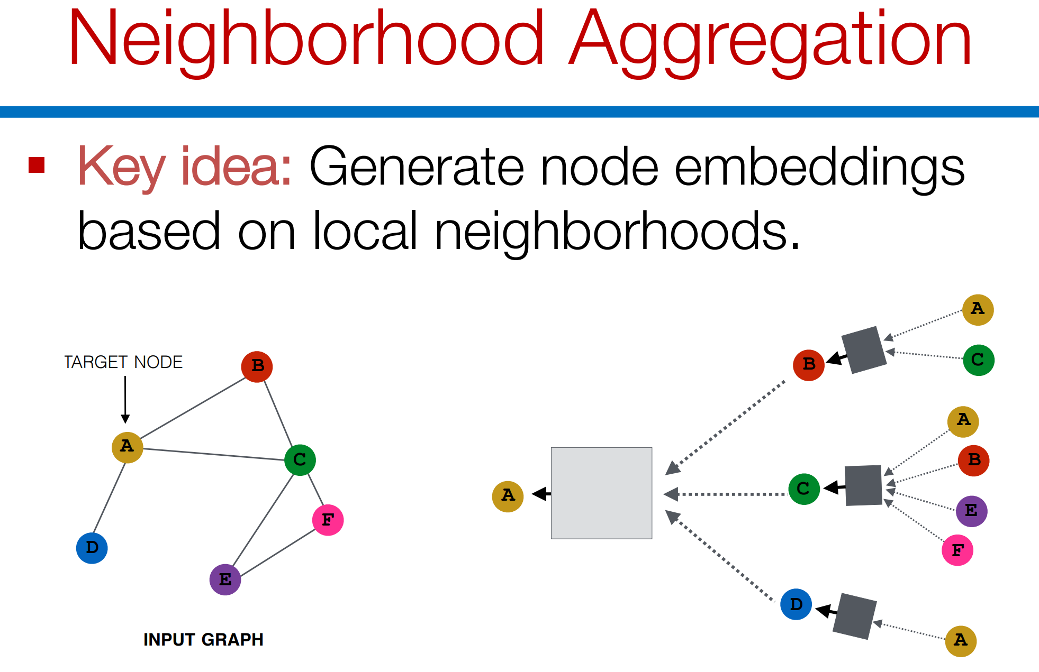

Slide 45
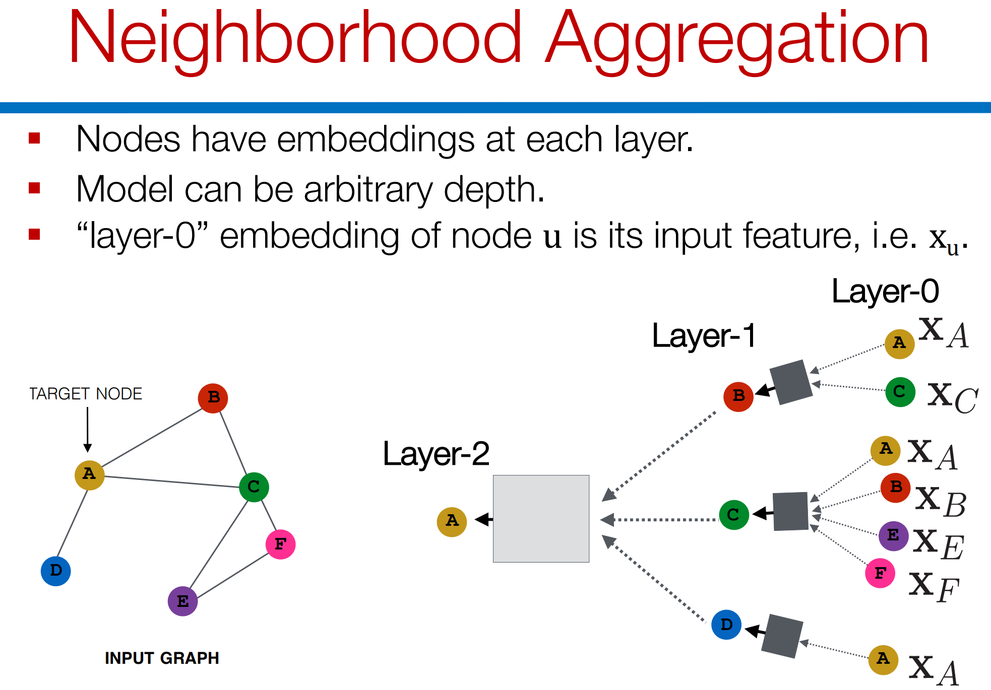

Slide 46
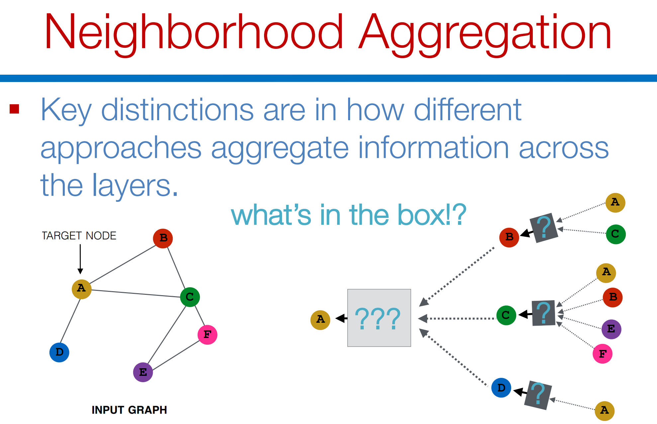

Slide 47
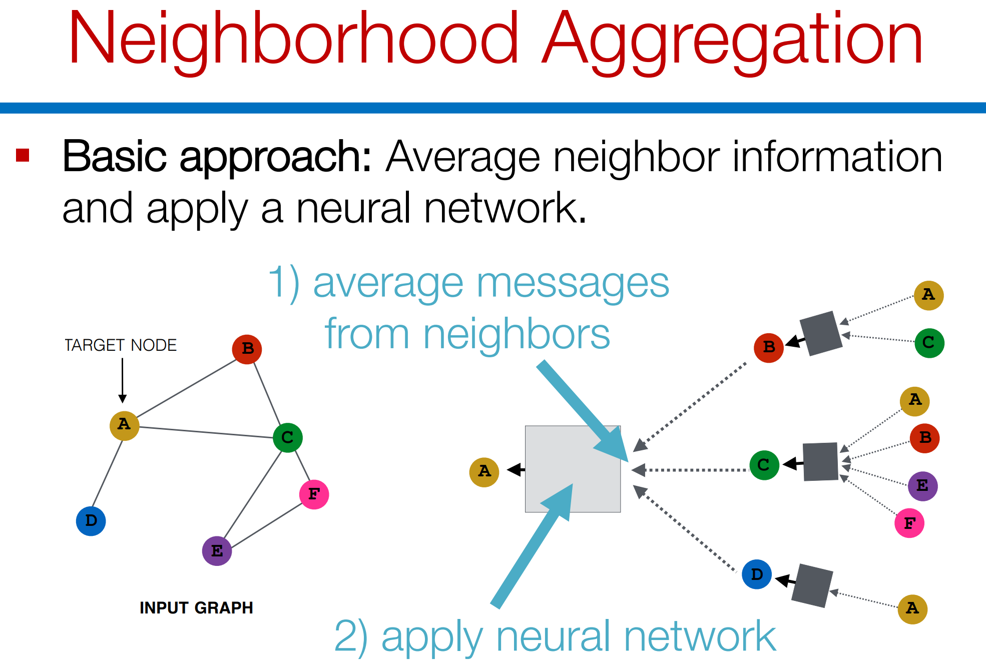

Slide 48
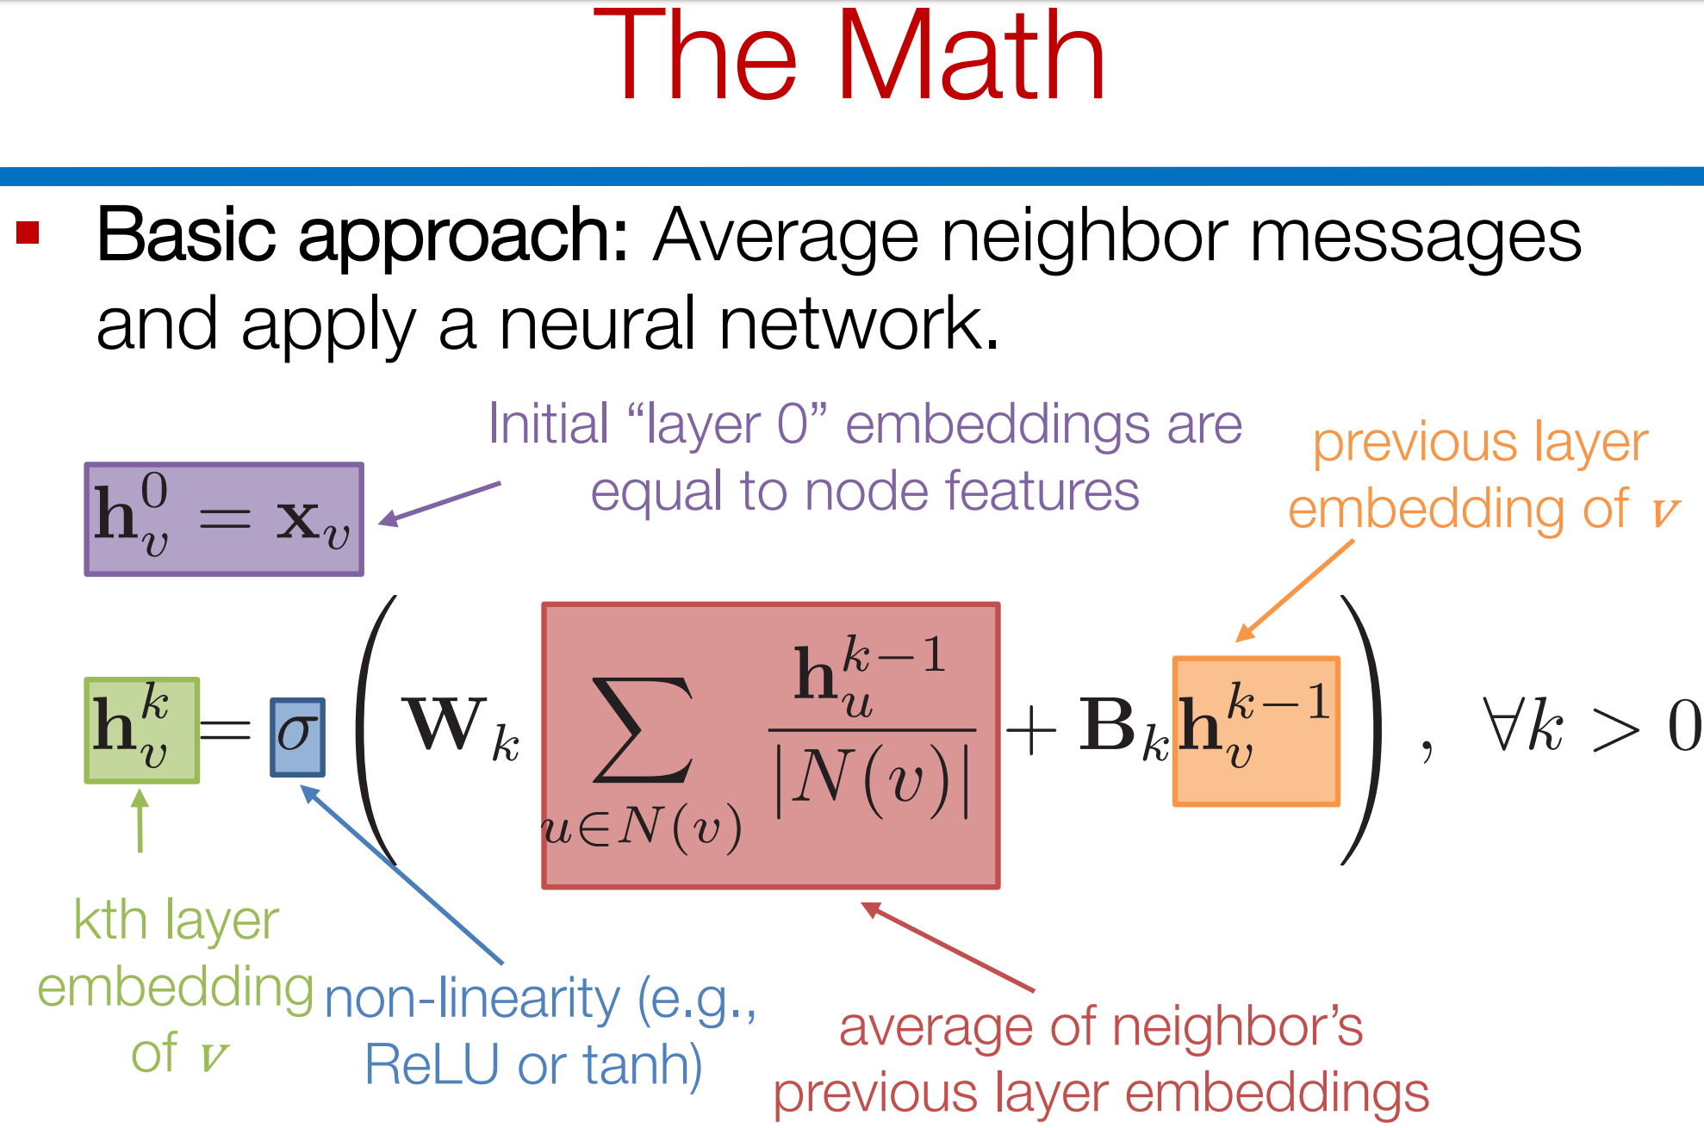

Slide 49
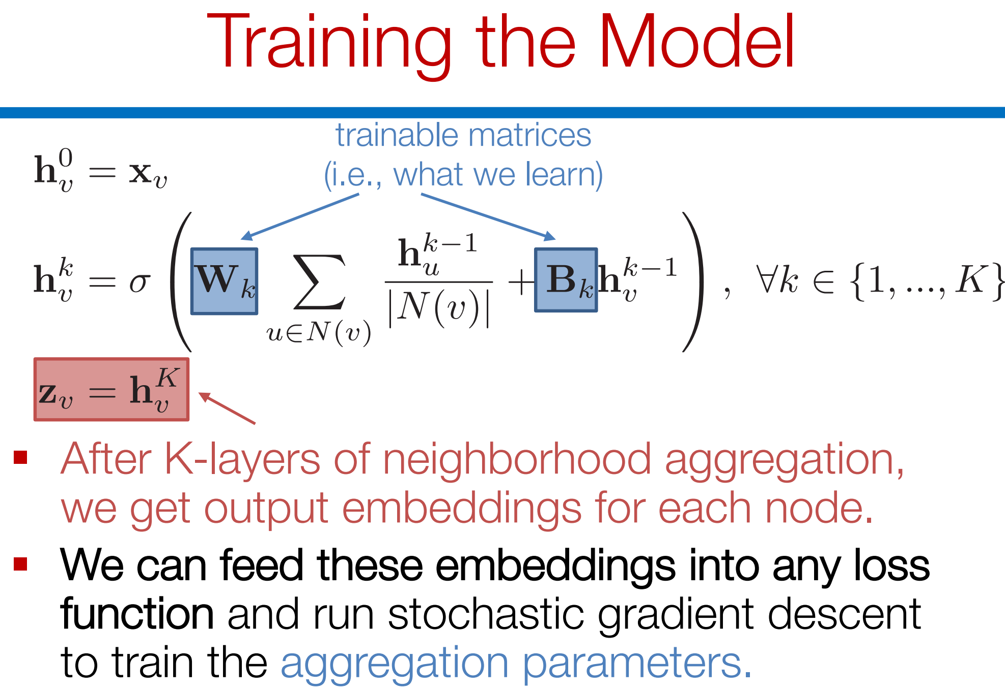

Slide 50
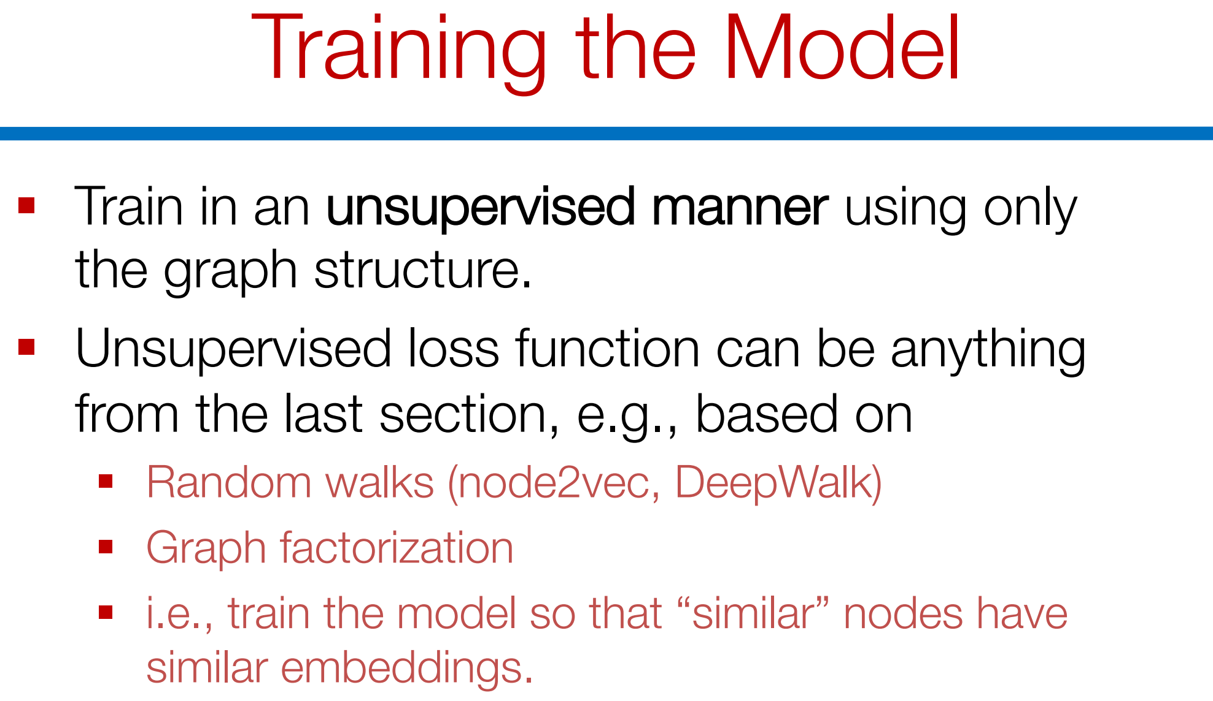

Slide 51
Ex: Unsupervised Loss function

Slide 52
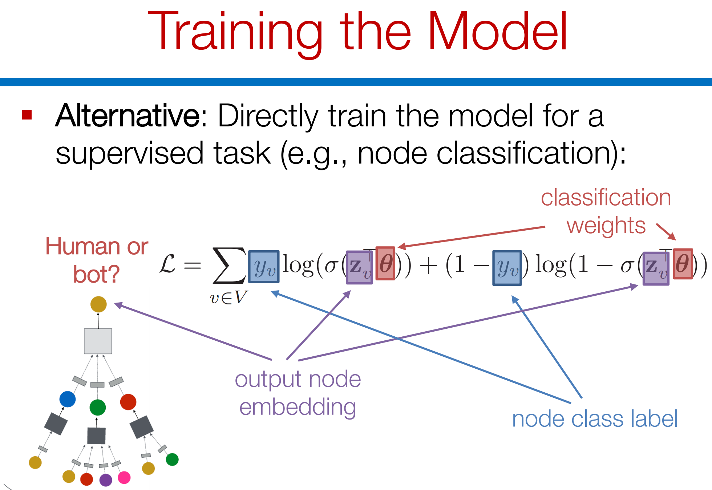
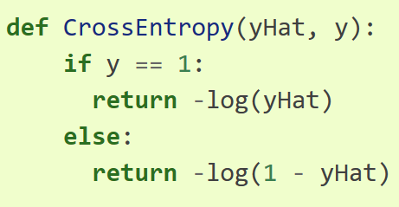

Slide 53
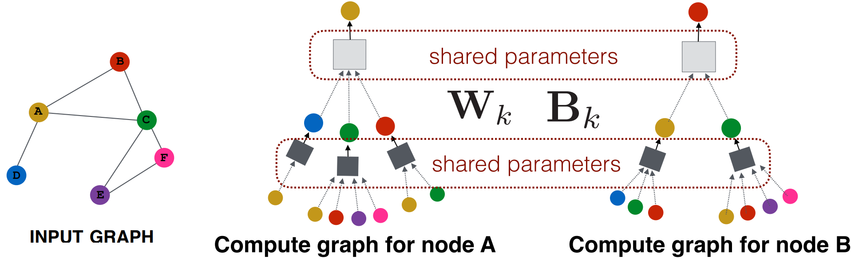
GCN overview
Choose aggregator
Choose loss function
Train on a bunch of nodes
Encode in feature space
Key difference: Can predict on unseen nodes

Slide 54
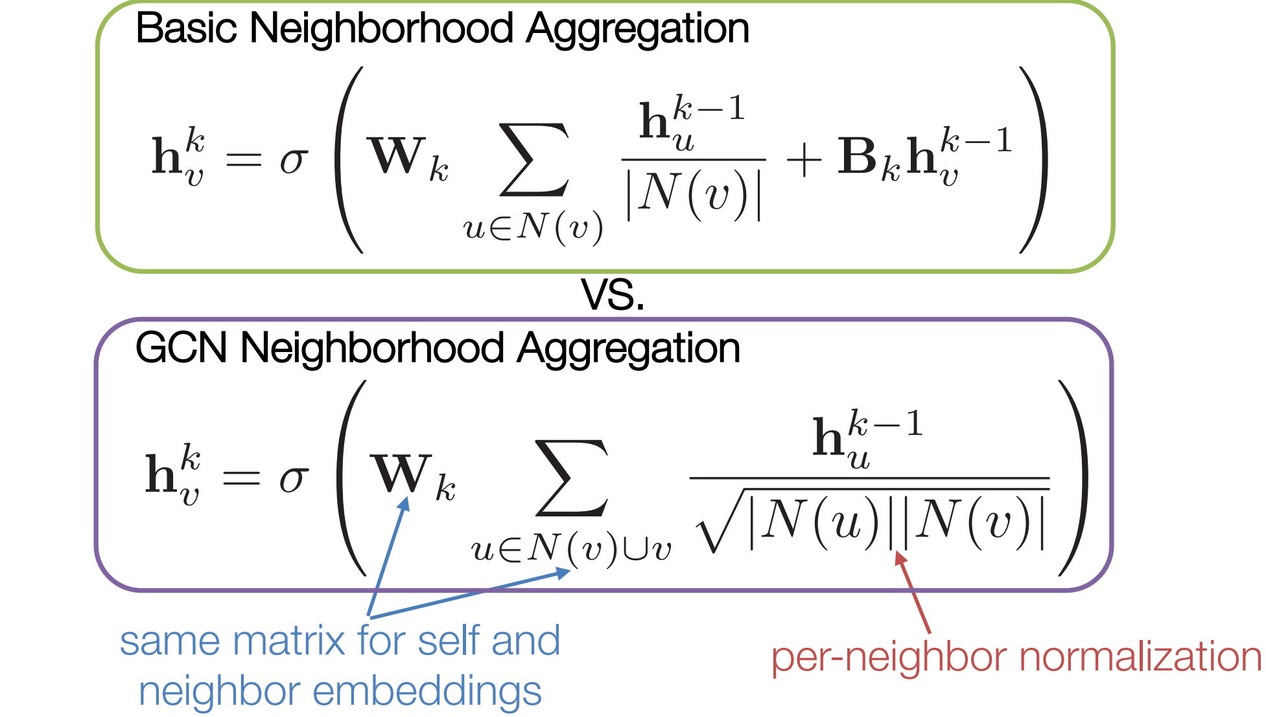

Slide 55
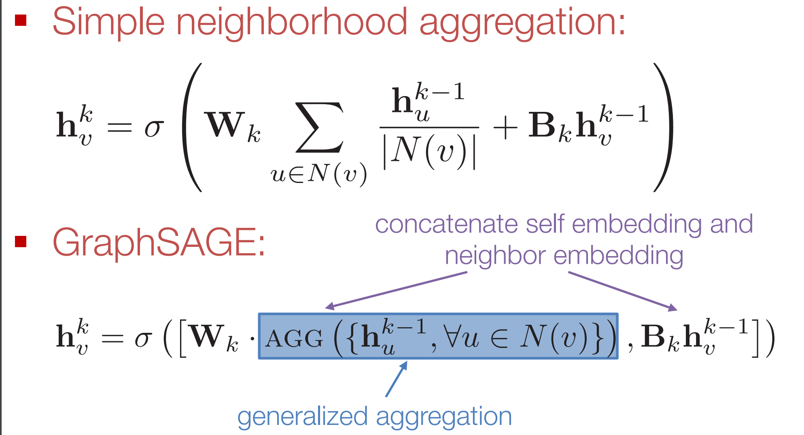
GraphSage

Slide 56
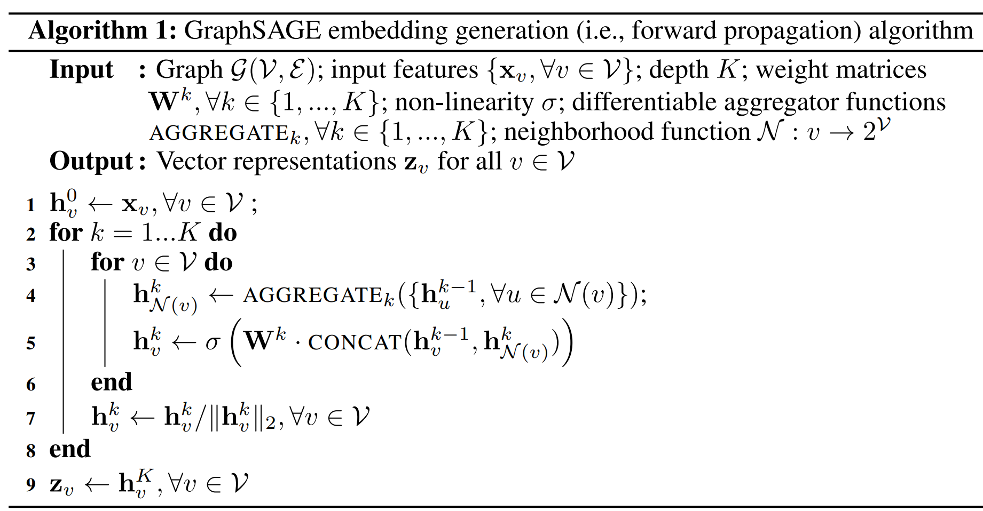
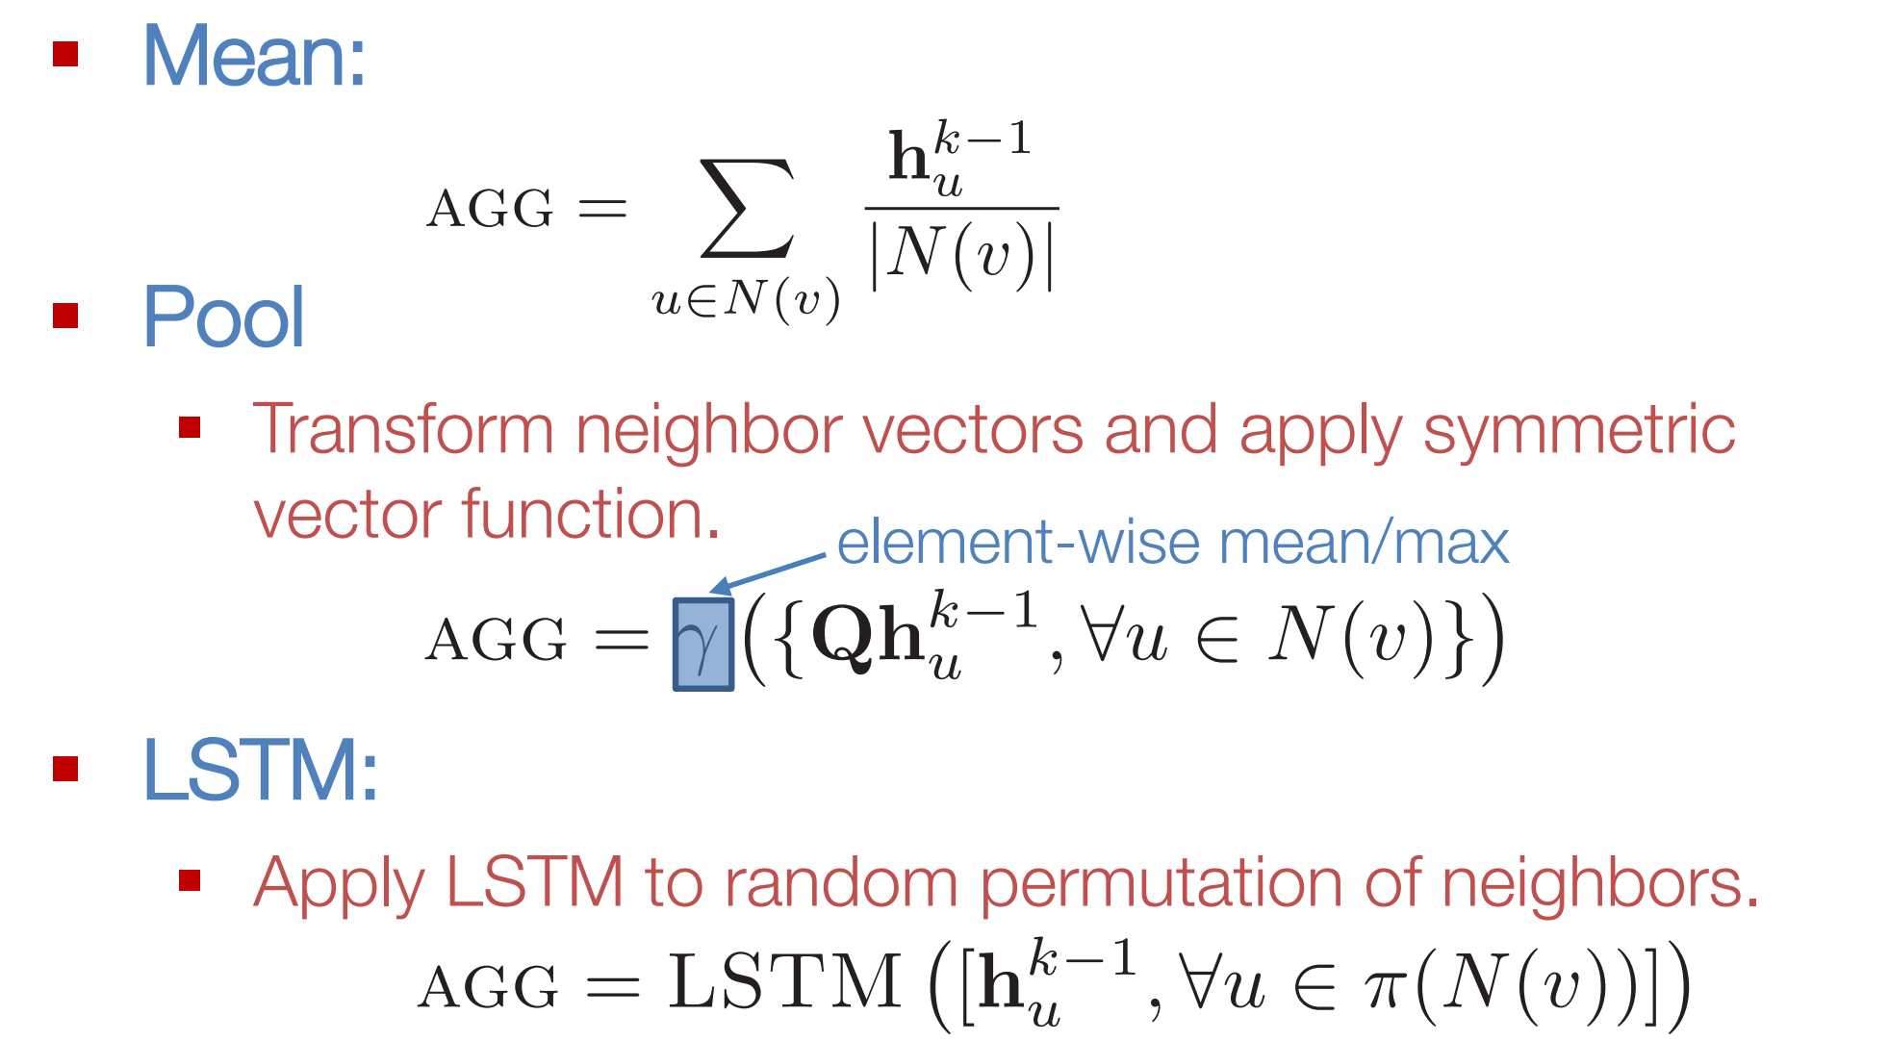
Merge information from neighbors and then pass through a non-linear activation function
Ex: Sigmoid, ReLu, Softmax, etc.

Slide 57
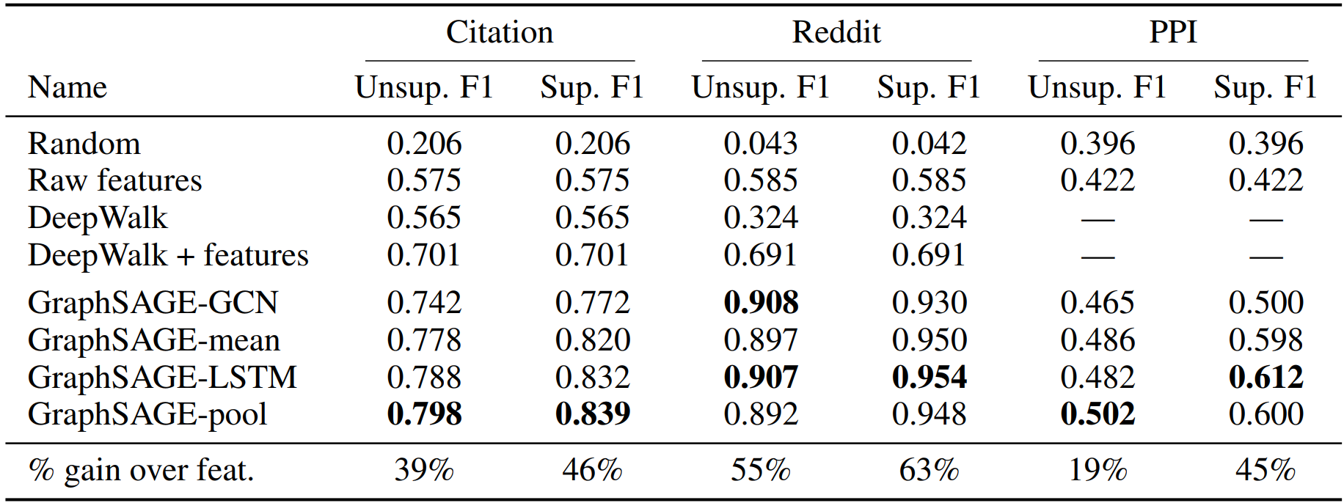
Results

Slide 58


Slide 59



Slide 60


Slide 61


Slide 62


Slide 63


Slide 64

Graph Attention Networks

Slide 65


Slide 66



Slide 67

Performance

Slide 68


MPNN
$h_{v}^{l}=Φ(h_{v}^{l−1},AGG({\{h}_{u}^{l−1}|∀u∈N\left(v\right)\}))$
$h_{G}=ψ(AGG′\left({\{h}_{v}^{L}\right| ∀v∈G\}))$
$G\left(V,E,X\right)$ is the graph
$v∈V$ are nodes. Analogously defined for edges
$X∈\left\{h_{v}^{0}∈R^{1×d}\right|∀v∈V\}$ are d-dimensional feature vectors
$φ\left(⋅\right) and ψ\left(⋅\right)$ are neural networks
$AGG and AGG^{′}$ are aggregation functions

Slide 69

The good bits…
Computation is linear to the number of edges
Encodes locality
Equivariant and Invariant to permutations
Equivariance: $f\left(P\left(V\right)\right)=P(f(V))$
Invariance: $f\left(V\right)=f(P(V))$
$P\left(V\right)$ is the permutation function
Therefore, isomorphic graphs produce the same representations

Slide 70

Limitations...
Expressivity: Does that mean non-isomorphic graphs also produce distinct representations?
No!
Shallow GNNs are generally better than deep GNNs
Over-squashing
Over-smoothing

Slide 71
Over-smoothing
Small-world property
Real-world graphs normally have small diameters
If layers= radius (diameter/2), all nodes receive messages from all nodes and hence they start to look increasingly similar

Slide 72

Over-squashing
Deep networks should do better since their receptive field is larger. They should learn long-range dependencies.
As depth increases, the receptive field increases exponentially.
However,
This information gets “squashed” into fixed-length vectors
The information path is through intermediate nodes that may smooth-out important long-range nodes.

Slide 73

Expressivity
MLPs are universal approximators

Slide 74

Can the same be said for MPNNs in the context of Graph?

Slide 75

MPNNs are not universal approximators!

Slide 76

A real-world example
No MPNNs can distinguish between these two graphs!
Why? There is a one-to-one correspondence between nodes across the two graphs in terms of the messages they would get.
Let’s study this a bit more formally

Slide 77

The 1-Weisfeiler Lehman test

Slide 78


Slide 79



Slide 80



Slide 81



Slide 82
Computation complexity
In each iteration, “messages "are aggregated from each neighbor
Message pass through each edge
Therefore, Complexity is O(i|E|)
i is the number of iterations.
Graph Isomorphism is NP-intermediate (not been proven to be NP-complete, but no poly-time algorithm exists)

Slide 83
Limits of the expressive power?
Lemma 1: If a k-layer MPNN maps nodes u and v to different embeddings, then WL algorithm decides that the k-hop neighborhoods of u and v are non-isomorphic.
Does it also hold in the opposite direction?
If WL decides the k-hop neighborhood to be non-isomorphic, can a GNN guarantee to generate different embeddings for u and v?
Yes, if the input features are countable.

Slide 84

Proof Sketch
Use an injective aggregation function
Injective: f(x)=f(y) iff x=y
Known result: Composition of injective functions is also injective.
Hence, if we use injective function across each of the k-layers, the result is equivalent to WL-test

Slide 85


Slide 86


Slide 87


Slide 88


Slide 89

MPNN function
$h_{v}^{l}=Φ(h_{v}^{l−1},AGG({\{h}_{u}^{l−1}|∀u∈N\left(v\right)\}))$
$AGG({\{h}_{u}^{l−1}|∀u∈N\left(v\right)\})=\sum_{∀u∈N(v)}{h_{u}^{l−1}}$
These results should be taken with a grain of salt!
We mostly work with real-valued embeddings
Higher-expressive power do not guarantee better performance
How powerful are Graph Neural Networks?, ICLR 2019.

Slide 90

Transformers

Slide 91





Graphormer [NeurIPS 2021]
Centrality Encoding:
$x_{i}$: original features of node i
$z^{−}$ and $z^{+}$ MLP outputs over in-degree and out-degree respectively.
Spatial Encoding:
Completing the layer

Slide 92

Expressivity
Can mimic sum pool (and meal pool)
Can distinguish graphs that 1-wl cannot

Slide 93

Results
Performance does not degrade as layers are increased
No effect of over-smoothing.

Slide 94

Results

Slide 95

Weakness of GCNs

Slide 96


Feature vector $f\left(o\right)=\{\frac{d\left(o,A1\right)}{k},…,\frac{d\left(o,Ak\right)}{k}\}$

Slide 97




P-GNN (ICML 2019)

Slide 98

Distortion
$\frac{1}{c1}d\left(x,y\right)≤d^{′}\left(f\left(x\right),f\left(y\right)\right)≤c2.d\left(x,y\right)$
$c1,c2≥1$ provides bounds on distance after dimensionality reduction
c₁ is contraction and c₂ is expansion
Distortion=$c1.c2$
If $c1=c2=1$, it is called isometric mapping

Slide 99


How many anchor sets?

Slide 100

Results

Slide 101

Results

Slide 102

GraphReach (IJCAI 2021)
Key idea: Replace shortest path distance RWR

